Slide 1






Ariba Network
Invoice Guide

Slide 2
Content
Introduction
Invoice Practices
Before you Begin Invoicing
  Viewing Customer Invoice Rules
  Electronic Invoice Routing and notifications
  Account Configuration and Invoice Archival
Creating Invoices
  PO Flip Invoice
  Credit Invoices
  Contract Invoice
  CSV Invoice
  Copy that Invoice
Modifying Invoices
Document Statuses, Searches and Reports
Ariba Network Support
2

Slide 3
Introduction
Procure-to-Pay Process
This document contains the requirements and training for your organization to create and submit invoices online to Moog Inc. via the Ariba Network.
Moog Inc. requires suppliers enabled on Ariba Network to submit electronic invoices through Ariba Network.
Note: Suppliers uploading CSV Invoices or utilizing cXML or EDI technologies should refer to the specification documents available on the Moog Inc. Supplier Information Portal.
3

Slide 4
2. Invoice Practices

Slide 5
Invoice Practices
Supported
Moog Inc. project specifics:
Tax data is accepted at the header/summary level of the invoice.
Shipping data is accepted at the header/summary level or at the line item level. If Collaborative Supply Chain is enabled, Shipping details are added at the header/summary level of the invoice.
Supported
Purchase Order Confirmations
Apply against a whole PO or line items
Advance Shipment Notices
Apply against PO when items are shipped
Detail Invoices
Apply against a single purchase order referencing
a line item
Partial Invoices
Apply against specific line items from a single purchase order
Contract Invoices
Apply against contracts
Credit Invoices
Item level credits; price/quantity adjustments
5

Slide 6
Invoice Practices
Not Supported
NOT Supported:
Summary or Consolidated Invoices
Apply against multiple purchase orders; not accepted by Moog Inc.
Invoicing for Purchasing Cards (P-Cards)
An invoice for an order placed using a purchasing card; not accepted by Moog Inc.
Duplicate Invoices
A new and unique invoice number must be provided for each invoice; Moog Inc. will reject duplicate invoice numbers unless resubmitting a corrected invoice that previously had a failed status on the Ariba Network
Paper Invoices
Moog Inc. requires invoices to be submitted electronically through the Ariba Network; Moog Inc. will no longer accept paper invoices
6

Slide 7
3. Before You Begin Invoicing

Slide 8
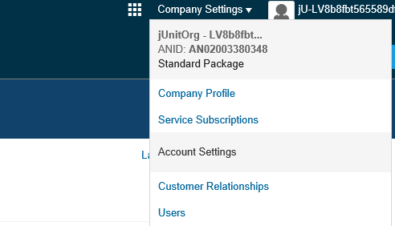

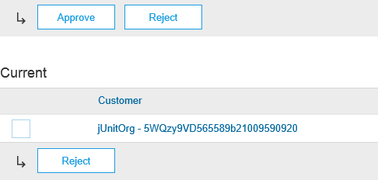


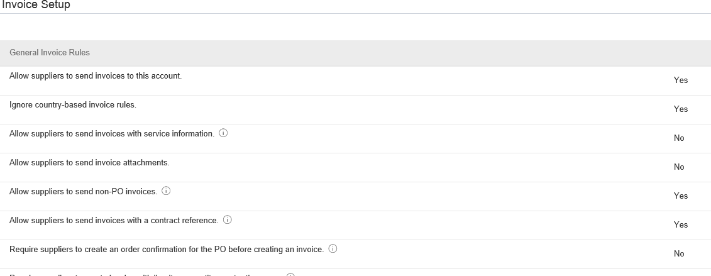
Customer Invoice Rules
These rules determine what you can enter when you create invoices.
2
Login to your Ariba Network account via
supplier.ariba.com
Select the Company Settings dropdown menu and under Account Settings, click Customer Relationships.
A list of your Customers is displayed. Click the name of your customer (Moog Inc.)
Scroll down to the Invoice Setup section and view the General Invoice Rules.
Click Done when finished.
3
4

Slide 9

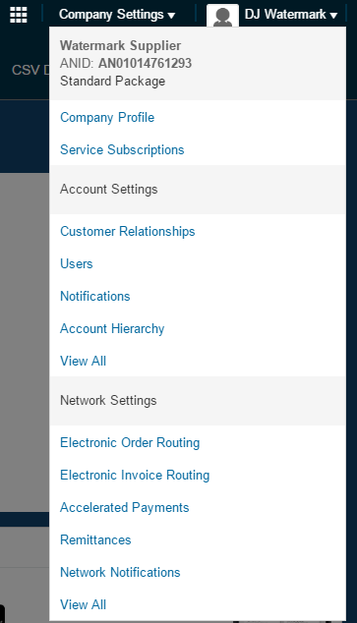
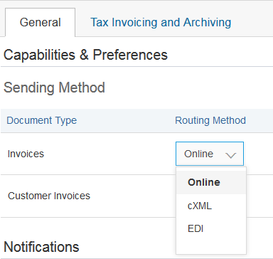

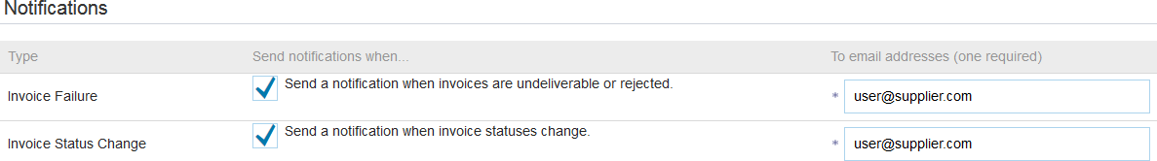

Electronic Invoice Routing and Notifications
1
Choose your Invoicing Routing and Notifications preferences:
Login to your Ariba Network account via
supplier.ariba.com
Select the Company Settings dropdown menu and under Network Settings, click Electronic Invoice Routing.
Choose one of the following Invoice routing methods from the dropdown menu: Online, cXML, EDI
Configure Notifications to emails. This allows people within your organization to receive email notifications if there are any Invoice Failures
3
2
and/or Invoice Statu
s Changes.
4

Slide 10
Account Configuration
Moog Inc. project specific tasks:
VAT ID / TAX ID – select your company name in the top right corner, go to Company Profile and select tab Business. In the section Financial Information enter your Vat ID / Tax ID.
Remittance address – select your company name in the top right corner and go to Remittances. In the EFT/Check Remittances section select Create and complete all required fields marked by an asterisk.
Payment methods – select your company name in the top right corner and go to Remittances. In the EFT/Check Remittances section select Create/Edit. In the Payment methods section choose one of the following options: ACH, Check, Credit card or Wire. Complete the details. The Remittance ID will be communicated to you by your buyer.
Test account creation (testing is required for integrated and catalog suppliers) - to create a test
account, select your name in top right corner and choose “Switch to Test ID.”
Currency The currency that Ariba Network uses in the service subscription area of your account is controlled by your organization’s location, which you specify in User Account Navigator > My Account > Preferences

Slide 11
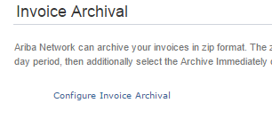

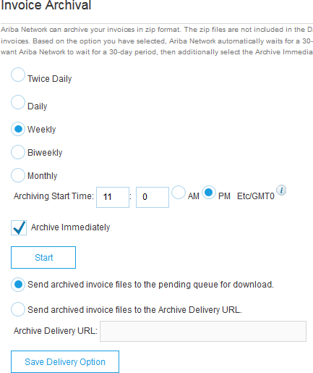


Invoice Archival
Configuring invoice archiving allows you to specify the frequency, immediacy, and delivery of zipped invoice archives. If you wish to utilize it, please follow these steps:
3
From the Company Settings dropdown menu, select “Electronic Invoice Routing”
Select the tab “Tax Invoicing and Archiving”
Scroll down to “Invoice Archival” and select the link for “Configure Invoice Archival”
Select frequency (Twice Daily, Daily, Weekly, Biweekly or Monthly), choose Archive Immediately to archive without waiting 30 days, and click Start.
  If you want Ariba to deliver automatically archived zip files to you, also enter an Archive Delivery URL (otherwise you can download invoices from your Outbox, section Archived Invoices).
  Note: After Archive Immediately started you can either
Stop it or Update Frequency any time.
You may navigate back to the “Tax Invoicing and Archiving” screen in order to subscribe to Long-Term Document Archiving for an integrated archiving solution. (More details within the Terms and Policies link.)
4
5

Slide 12
4. Creating Invoices

Slide 13
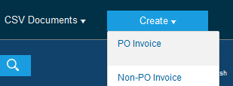
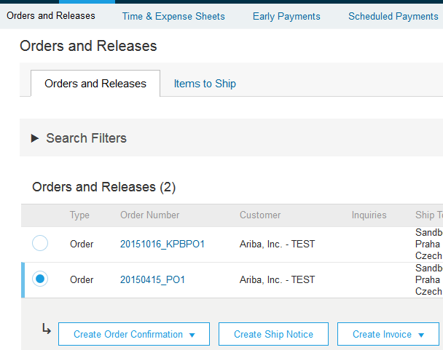

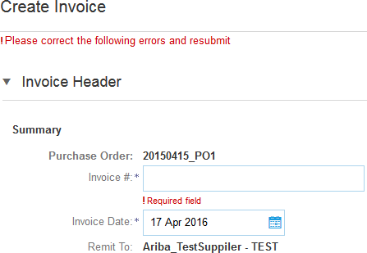
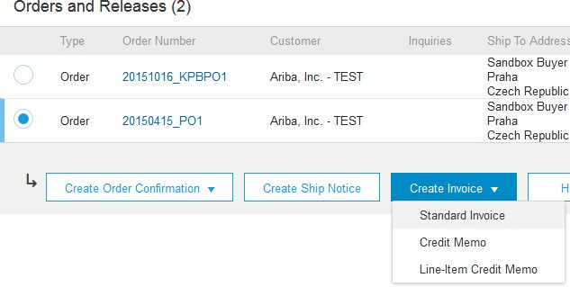
PO Flip Invoice
To create a “PO-Flip” invoice (or an invoice derived from a PO that you received via the Ariba Network):
1
From the home screen within your Ariba Network account, select the “Create” dropdown menu and select “PO Invoice”.
For PO Invoice select a PO number.
Click on the Create Invoice button and then choose Standard Invoice.
Invoice is automatically pre-populated with the PO data. Complete all fields marked with an asterisk and add tax as applicable. Review your invoice for accuracy on the Review page. If no changes are needed, click Submit to send the
2
invoice to Moog Inc.
4
3

Slide 14
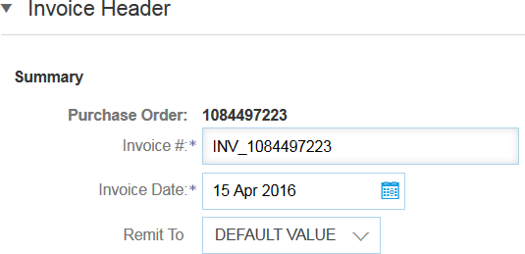


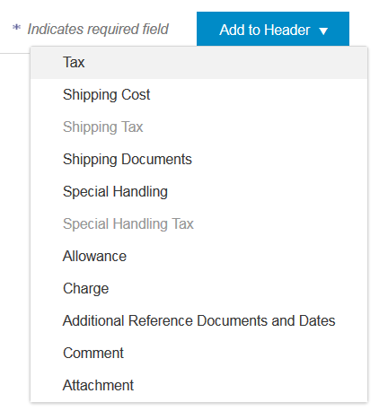

PO Flip Invoice- Header
Invoice is automatically pre-populated with the PO data. Complete all fields marked with an asterisk and add tax as applicable.
1
2
Enter an Invoice # which is your unique number for
invoice identification. The Invoice Date* will auto-populate.
Select Remit-To address from the drop down box if you have entered more than one.
Tax and Shipping can be entered at either the Header or Line level by selecting the appropriate radio button.
You can also add some additional information to the Header of the invoice such as: Special Handling, Payment Term, Comment, Attachment**, Shipping Documents
Scroll down to the Line items section to select the line items being invoiced.
3
3
4
4
Note: Support of additional Reference Documents & Dates is applicable for CSC customers only; Attachment file size should not exceed 40MB.

Slide 15

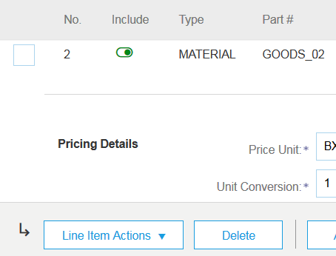

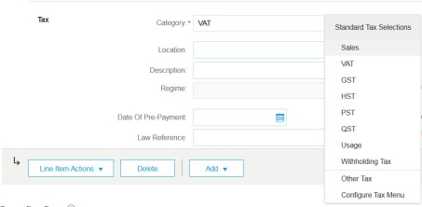



PO Flip Invoice- Line Items
Line Items section shows the line items from the Purchase Order.
1
Review or update Quantity for each line item you are invoicing.
Click on the line item’s Green check mark to exclude it from the invoice, if line item should not be invoiced OR click the check box on the left of the item and click Delete to remove the line item from the invoice. You can generate another invoice later to bill for that item.
Select the line item to which tax is to be applied using the Line Item # checkbox. To apply the same tax to multiple line items select those line items to be taxed at the desired rate.
To configure additional Tax Options within the Tax Category tool, use the Configure Tax Menu option.
Check Tax Category and use the drop down to select from the displayed options. Click Add to Included Lines. (see Slide 14 for additional details)
2
3
4
5

Slide 16
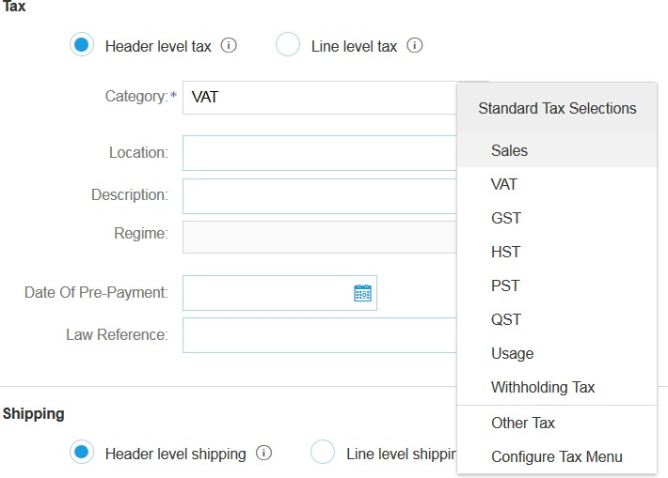
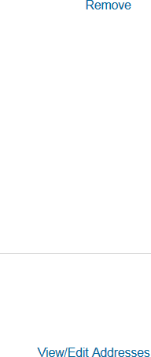
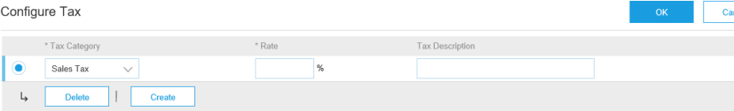
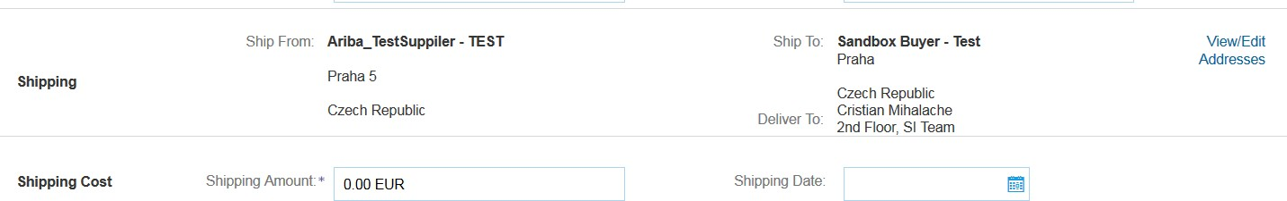

PO Flip Invoice-
Additional Tax Options & Line Item Shipping
To configure additional tax options click Configure Tax Menu under the Tax Category drop down. Create new tax categories and as needed.
2
1
3
To apply different tax rates to each line item select
the Line Item.
Click Line Item Actions > Add > Tax. Upon refresh, the Tax fields will display for each selected line item.
To remove a tax line item, click Remove.
Within each line item, select Category, then either populate the Rate(%) or Tax Amount. Click Update.
If line level shipping has been selected at the line level, enter shipping cost to the applicable line items.
4
5

Slide 17
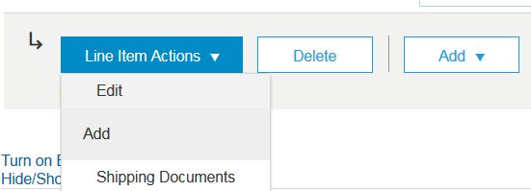
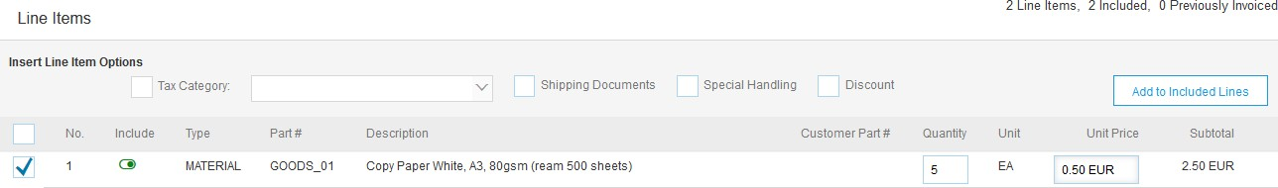
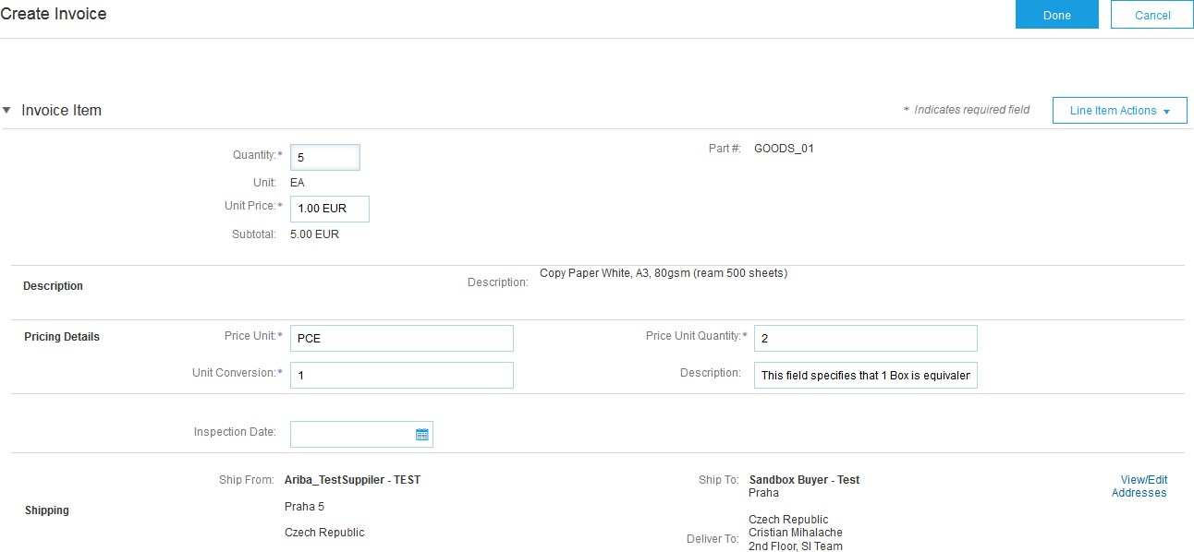
PO Flip Invoice-
Detail Line Items
6. Additional information can be viewed at the Line Item Level by editing a Line Item.
6

Slide 18
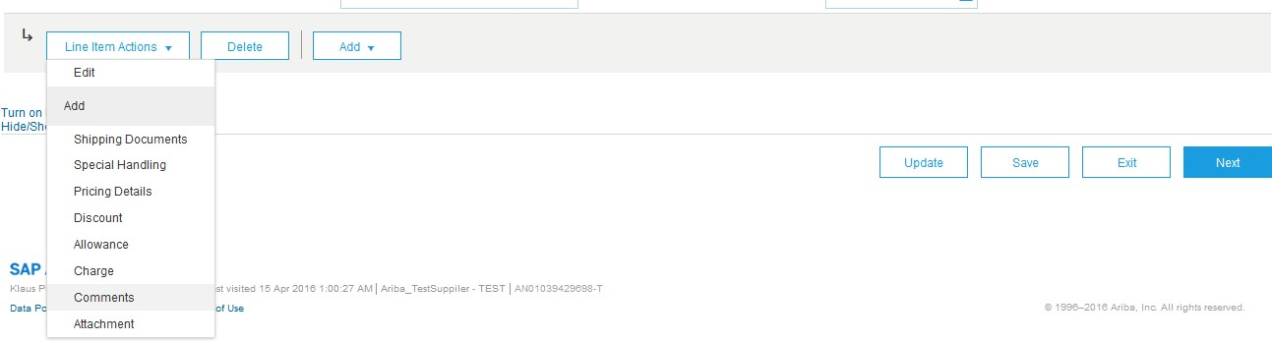


PO Flip Invoice – Line Item Comments
To add comments at the line items select Line Items, then click at Line Item Actions >Add > Comments.
Upon refresh or Update, the Comments field will display. Enter applicable Comments in this field.
Click Next.
1 3
2

Slide 19
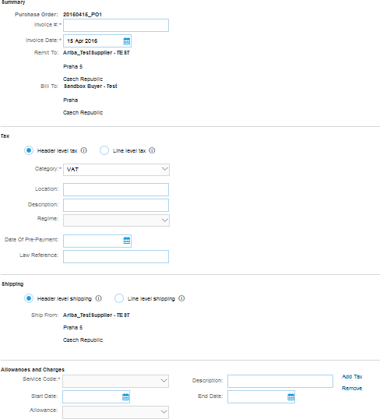
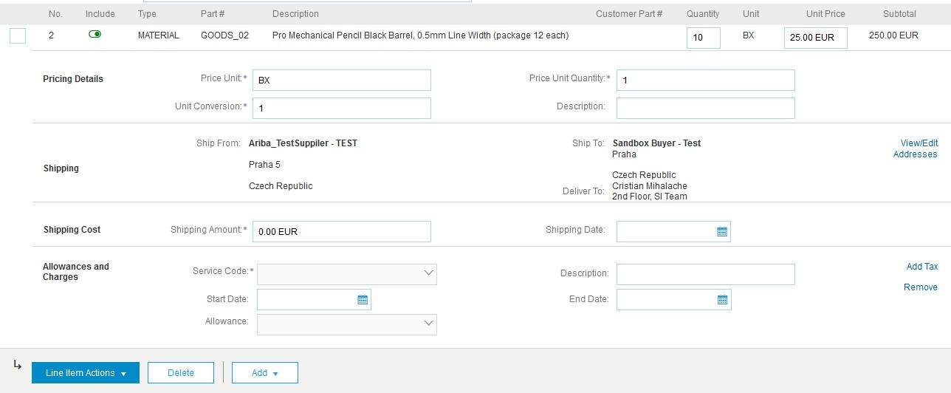
PO Flip Invoice – with Allowances and Charges
If Allowances and Charges are included in the PO, these will convert to the Invoice at either Invoice Header or Lined Item Level based on where the information is on PO
1
Header Allowance and Charges
Line level Allowance and Charges
2

Slide 20
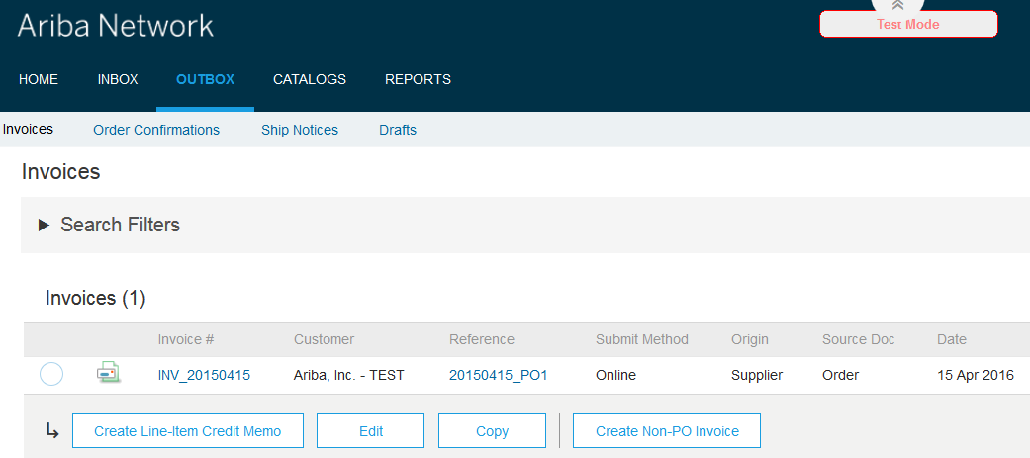
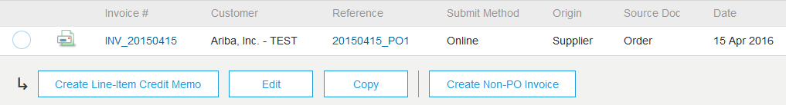
Credit Memo / Negative Invoice
To create a credit memo against an Invoice,
Select the “OUTBOX” tab.
Select your previously created invoice.
Click the button on the Invoice screen for Create Line-Item Credit Memo.
Complete information in the form of Credit Memo (the amount and taxes will automatically be negative). Make sure that all required fields marked with
1
asterisks are filled in.
Click Next.
Review Credit Memo.
Click Submit.
2

Slide 21
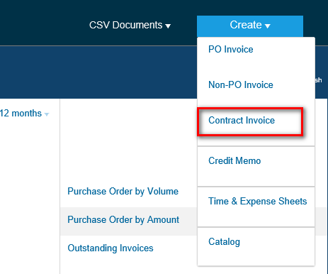

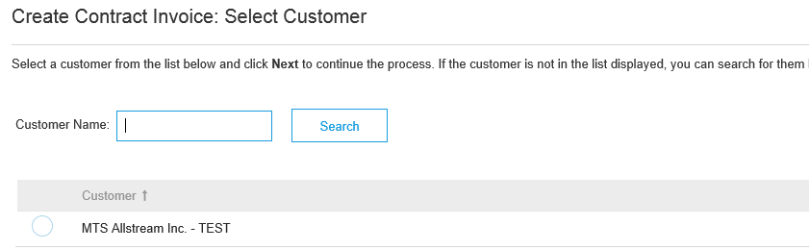


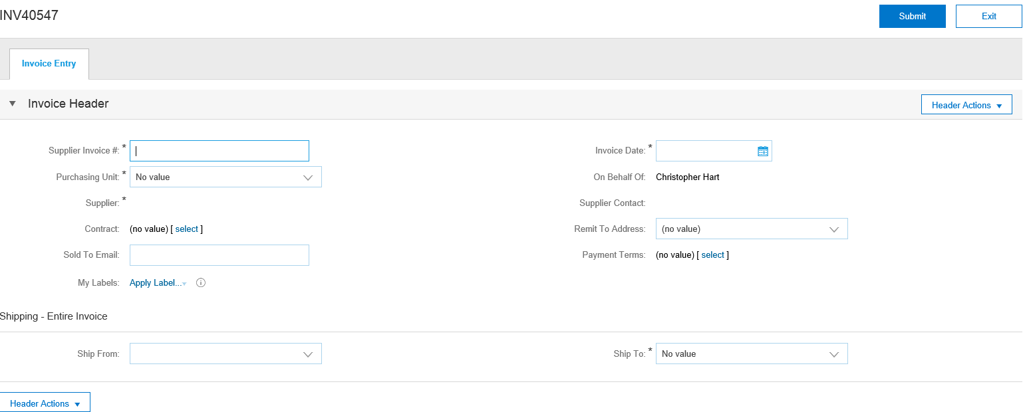
Contract Invoice
To create a Contract Invoice:
1. From the home screen within your Ariba Network account, select the
“Create” dropdown menu and
1
select “Contract Invoice”.
Select Moog from the Customer dropdown list.
Complete invoice entry with all fields marked with asterisk (*).
2
3

Slide 22
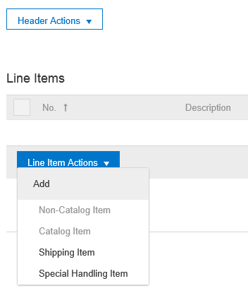
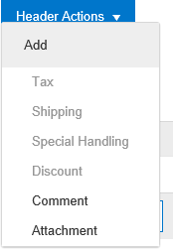


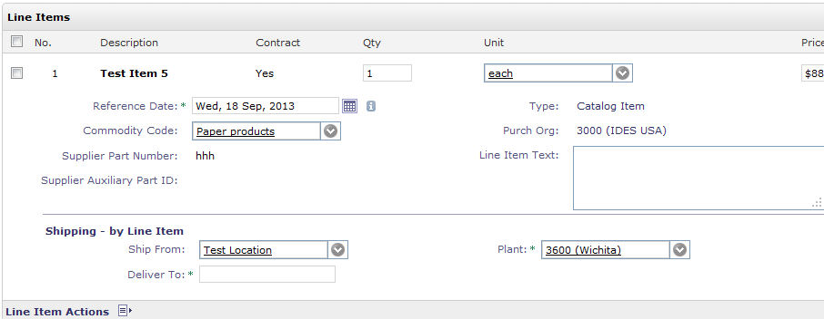


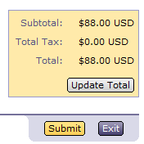

Contract Invoice
There is an option to add Tax, Shipping, Special Handling, Discount, Comments and Attachments to Contract Invoices.
1
1
To add Line items to the Invoice:
Choose from Non-catalog or Catalog options.
Enter required fields marked with an asterisk (*).
Update Total.
Click on Submit button to submit the invoice.
2
3
4

Slide 23
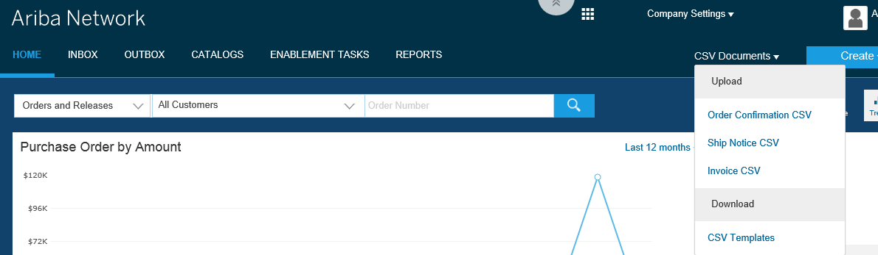

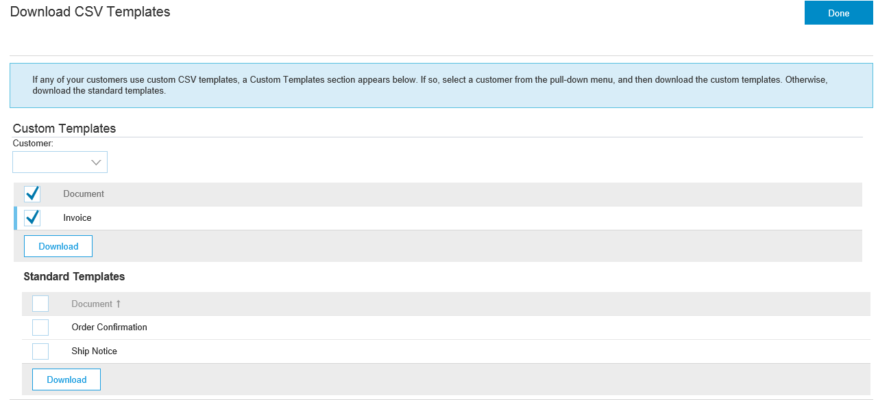
CSV Invoices Upload
To access a customer’s
CSV file template, go to
CSV Documents> Download> CSV Templates.
From the Download CSV Templates screen, select Moog as customer, mark Invoice under Document and click Download.

Slide 24
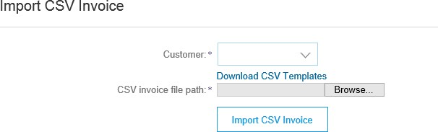
CSV Invoices Upload
Populate the template and upload it from CSV Documents > Upload > Invoice CSV.
The CSV file is processed by Ariba Network and forwarded to the customer in the form of cXML message.
For more information, please read the CSV Upload Guide available from the Supplier Information Portal.

Slide 25
“Copy This Invoice”
Copy Invoice Feature:
Suppliers can copy an existing invoice to use as a basis for a new invoice. The copy includes all fields except the invoice date, invoice number, exchange rate, and attachments. The supplier can edit and submit the new invoice without having to reenter a lot of information. This feature applies to standard invoices and contract-based invoices. Invoices can be copied regardless of status.
Common uses for this feature include:
Submitting invoices for a balance due
Submitting corrected invoices in cases where the first attempt was rejected
Enabling This Feature
This is an out-of-the-box feature available to all customers. It requires no action to configure it.
Limitations
You cannot copy the following:
Summary invoices (invoices that refer to multiple purchase orders)
Credit memos and line-level credit memos
Self-signed invoices (invoices that are digitally signed by the supplier)
Invoices with 1000 or more invoice lines

Slide 26
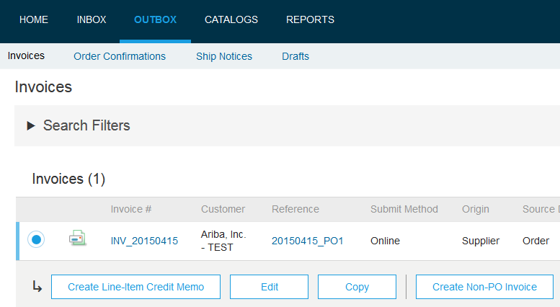
How to Copy this Invoice
To copy an existing invoice in order to create a new invoice:
1
2
Select the “OUTBOX” Tab
Either Select the radio button for the invoice you want to copy, and click Copy. OR Open the invoice you want to copy.
On the “Detail” tab, click Copy This Invoice.
Enter an invoice number.
For VAT lines, make sure the date of supply at the line level is correct.
Edit the other fields as necessary.
Click Next, review the invoice, and save or submit it.

Slide 27
5. Modifying Invoices

Slide 28
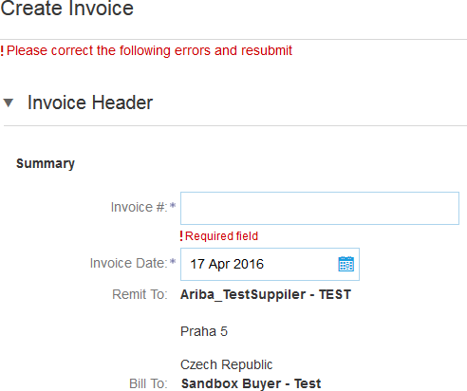
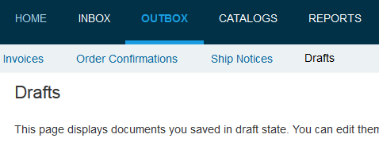
PO Flip Invoice – Review, Save, Submit
Review your invoice for accuracy from the Review page. Scroll down the page to view all line item details and invoice totals.
In case of any errors, you will get a notification in red where information should be corrected.
If no changes are needed, click Submit to send the invoice to Moog Inc.
If changes are needed, click Previous to return to previous screens and make
corrections before submitting.
Alternatively, Save your invoice at anytime during invoice creation to work on it later.
You may resume working on the invoice by selecting it from Outbox> Drafts on your Home page.
Note: You can keep draft invoices for up to 7 days.
3 1
2
4

Slide 29
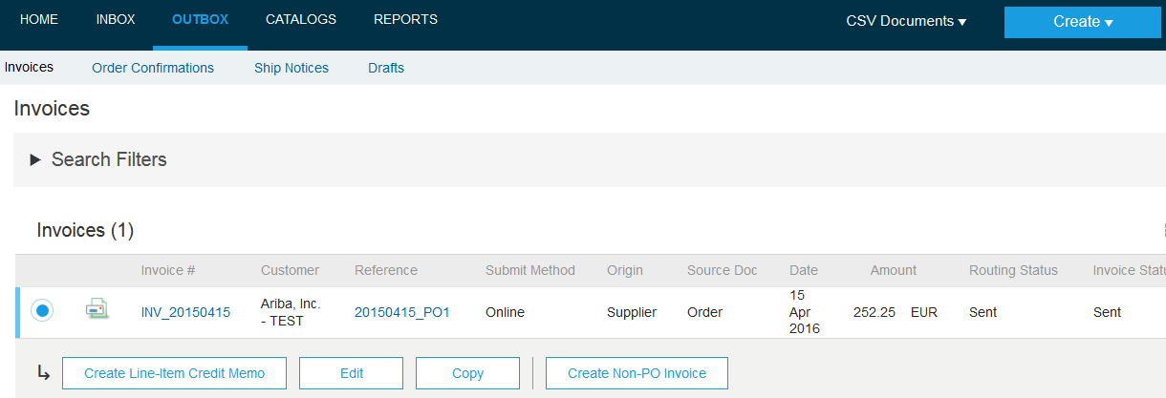

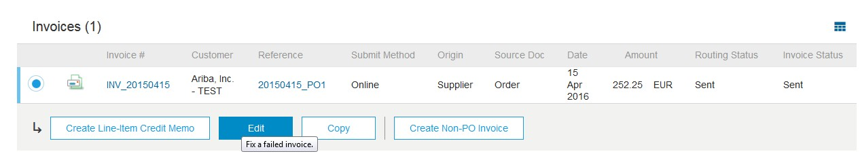


Cancel, Edit and Resubmit Invoices
Select the “OUTBOX” tab.
In the Invoice # column, click the invoice link to view details of the invoice.
Click Cancel. The status of the invoice changes to “Canceled.”
Click the Invoice # for the failed, canceled, or rejected invoice that you want to resubmit and click Edit.
Click Submit on the Review page to send the invoice.
1
2
3
4
3
4

Slide 30
6. Document Status, Searches, and Reports

Slide 31
Check Invoice Status
Check Status:
If you configured your Invoice Notifications as noted earlier in this presentation, you will receive emails regarding invoice status.
You can also check invoice status from the Outbox by selecting the invoice link.
Routing Status
Reflects the status of the transmission of the invoice to Moog Inc. via the Ariba Network.
Obsoleted – You canceled the invoice
Failed – Invoice failed Moog Inc. invoicing rules. Moog Inc. will not receive this invoice
Queued – Ariba Network received the invoice but has not processed it
Sent – Ariba Network sent the invoice to a queue. The invoice is awaiting pickup by the customer
Acknowledged – Moog Inc. invoicing application has acknowledged the receipt of the invoice

Slide 32
Check Invoice Status
Invoice Status
Reflects the status of Moog Inc.’s action on the Invoice.
Sent – The invoice is sent to the Moog Inc. but they have not yet verified the invoice against purchase orders and receipts
Cancelled – Moog Inc. approved the invoice cancellation
Paid – Moog Inc. paid the invoice / in the process of issuing payment. Only if Moog Inc. uses invoices to trigger payment.
Approved – Moog Inc. has verified the invoice against the purchase orders or contracts and receipts and approved if for payment
Rejected – Moog Inc. has rejected the invoice or the invoice failed validation by Ariba Network. If Moog Inc. accepts invoice or approves it for payment, invoice status updated to Sent (invoice accepted) or Approved (invoice approved for payment)
Failed – Ariba Network experienced a problem routing the invoice

Slide 33
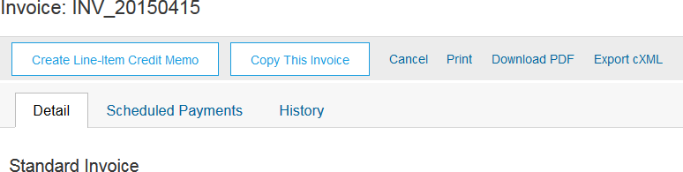
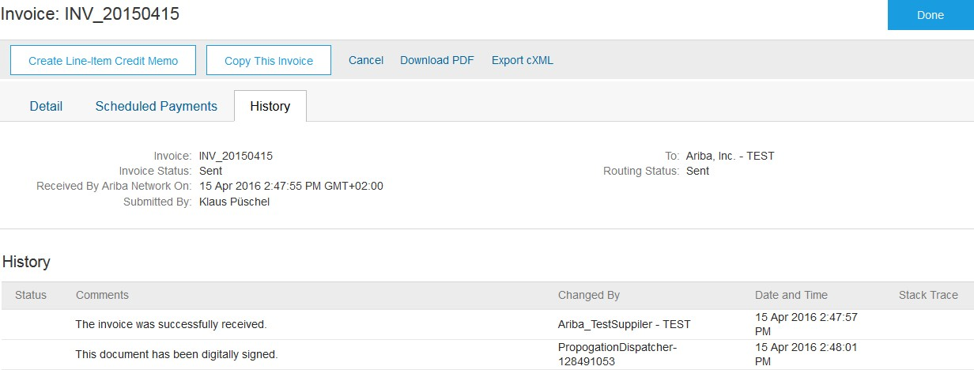
Check Invoice History
Access any invoice:
1
1. Click on the History tab
to view status details and invoice history.
History and status
comments for the invoice are displayed.
Transaction history can be used in problem determination for failed or rejected
transactions.
When you are done reviewing the history, click Done.
4
2

Slide 34
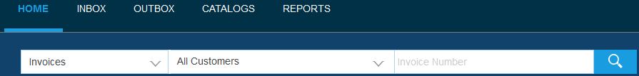
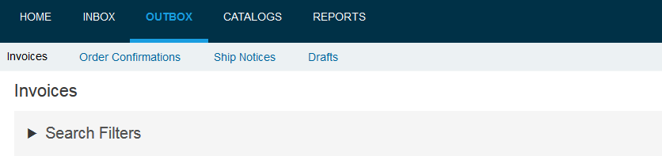
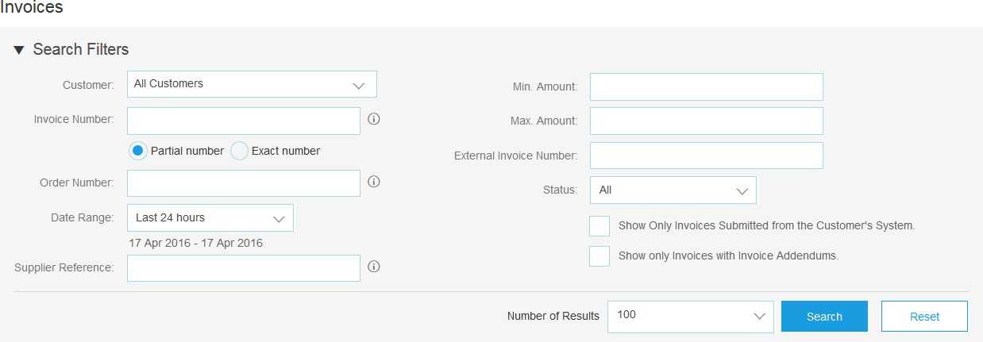

Search for invoice - Quick Search and Refined Search
Quick Search:
From the Home Tab, Select Invoices in the Document type to search,
Select Moog Inc. from Customer Drop down menu.
Enter Document # , if known. Select Date Range, up to 90 days for Invoices and Click Search.
Refined Search: Allows a refined search of Invoices within up to 90 last days.
Search Filters from Outbox (Invoices).
Enter the criteria to build the desired search filter.
Click Search.
1 2 3
4
5
6

Slide 35

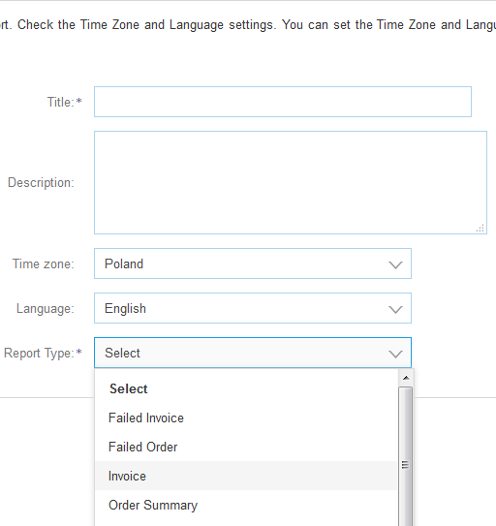
Search for invoice - Reports
Invoice reports provide information on invoices you have sent to customers for tracking invoices over time or overall invoice volume for a period of time.
Failed Invoice reports provide details on failed and rejected invoices. These reports are useful for troubleshooting invoices that fail to route correctly.
Note: Reports can be created by Administrator or User with appropriate permissions.
1
2
Click the Reports tab from the menu at the top of the page.
Click Create. Fill in required Information. Select an Invoice report type — Failed Invoice or Invoice.
Click Next.
Note: Select (and higher) members may choose Manual or Scheduled report. Set scheduling information if Scheduled report is selected. After specifying Customer and Created Date in Criteria click Submit. You can view and download the report in CSV format when its status is Processed.
For more detailed instructions on generating reports, refer to the Ariba Network Transactions Guide found on the HELP page of your account.

Slide 36
7. Ariba Network Support

Slide 37
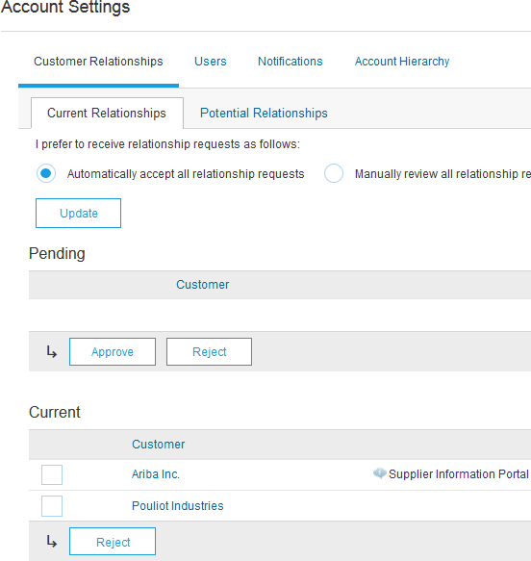

Training and Resources
Moog Inc. Supplier Information Portal
1. Select the name of your company in the top right corner and then click the Customer Relationships link.
2 3
1
2. Select the buyer name
transactional
The Customer Invoice
to view rules: Rules
determine what you can enter when you create invoices
3. Select Supplier Information Portal to view the following presentations to learn more about transacting with Moog Inc.:
Account Configuration Guide
Moog Inc. Purchase Order Guide
Moog Inc. Invoice Guide

Slide 38


Training and Resources
Ariba Network Standard Documentation
Go to: http://supplier.ariba.com and click the Help link.
Click Help Center.
Click on Learning Center to access Product Documentation. The Learning Center was created for users interested in technical product documentation. The Learning Center was design to allow you to browse the full library of product documentation and tutorials.
1
2
Note: Only a subset of the documentation is available in a pre-login state. For full content access, login to your Ariba Network Supplier account and access the same Help menu.
3

Slide 39

Training and Resources
Ariba Network Standard Documentation
From within your Ariba Network account:
Click on Help Center to access Standard Documentation material.
Depending on which screen you are in within your account, the content will automatically update to reflect materials that may be helpful to you in relation to the items on the screen. You can also type in key word searches to adjust the content shown.
Click Documentation (bottom)
View Ariba Network
Administrator’s documentation.

Slide 40




Help Center
Helpful things to know
Popular Topics: Title links are selected for you based on the solution that you were using,
privileges & default language when you clicked on Help.
Click on the link to view the content item. You will be able engage with the content: author, view how many community users have viewed the content and have flagged the content as being helpful to you, and report problems with the content.
Perform a search to find content not found under Popular Topics. Results can be sorted or filtered.
Under Learning you can find the Product Documentation available for Users or Administrators.
Popular Tags: These are the tags associated with our most popular content items per solution. It is a quick way to find documents related to the topic.
1
2
3
4
5

Slide 41
Training and resources
Ariba Network standard documentation and useful links
Useful Links
Ariba Supplier Membership page - http://www.ariba.com/suppliermembership
Ariba Network Hot Issues and FAQs - https://connect.ariba.com/anfaq.htm
Ariba Cloud Statistics – http://trust.ariba.com
  Detailed information and latest notifications about product issues and planned downtime
- if any - during a given day
Ariba Discovery - http://www.ariba.com/solutions/discovery-for-suppliers.cfm
Ariba Network Notifications - http://netstat.ariba.com
  Information about downtime, new releases and new features

Slide 42
Who should you contact?
Supplier Support During Deployment
Ariba Network Registration or Configuration Support
Please contact moogenablement@ariba.com for any questions regarding registration, configuration, Supplier fees, or general Ariba Network questions.
Moog Inc. Business Process Support
Please contact the Moog Inc. Supplier Enablement team at aribasupport@moog.com for business-related questions.
Supplier Support Post Go-Live
Ariba Network Help Center (referenced in previous slides). Accessible through your Ariba Network
account (top/right corner).

Slide 43
© 2018 SAP SE or an SAP affiliate company. All rights reserved.
No part of this publication may be reproduced or transmitted in any form or for any purpose without the express permission of SAP SE or an
SAP affiliate company.
SAP and other SAP products and services mentioned herein as well as their respective logos are trademarks or registered trademarks of SAP SE
(or an SAP affiliate company) in Germany and other countries. Please see http://global12.sap.com/corporate-en/legal/copyright/index.epx for additional trademark information and notices.
Some software products marketed by SAP SE and its distributors contain proprietary software components of other software vendors. National product specifications may vary.
These materials are provided by SAP SE or an SAP affiliate company for informational purposes only, without representation or warranty of any kind, and SAP SE or its affiliated companies shall not be liable for errors or omissions with respect to the materials. The only warranties for SAP SE or SAP affiliate company products and services are those that are set forth in the express warranty statements accompanying such products and services, if any. Nothing herein should be construed as constituting an additional warranty.
In particular, SAP SE or its affiliated companies have no obligation to pursue any course of business outlined in this document or any related presentation, or to develop or release any functionality mentioned therein. This document, or any related presentation, and SAP SE’s or its affiliated companies’ strategy and possible future developments, products, and/or platform directions and functionality are all subject to change and may be changed by SAP SE or its affiliated companies at any time for any reason without notice. The information in this document is not a commitment, promise, or legal obligation to deliver any material, code, or functionality. All forward-looking statements are subject to various risks and uncertainties that could cause actual results to differ materially from expectations. Readers are cautioned not to place undue reliance on these forward-looking statements, which speak only as of their dates, and they should not be relied upon in making purchasing decisions.

