Slide 1
Moog Inc.
Light Account Supplier Summit
Notes:
Good _____ and welcome to the Ariba Network Light Account Supplier Summit for <<Buyer Name>>. My name is _________, and I’ll be your host and presenter today. In today’s session, representatives from SAP Ariba and <<Buyer Name>> will talk about the new, free transacting capability on Ariba Network, and what this will mean to you.
24 hours after today’s session you will receive a copy of the recording of today’s presentation. At the end of today’s summit, we have set aside some time for a live Q&A where myself or a representative from the <<Buyer Name>> team will be answering your questions. To submit a question to be answered during the Q&A, please send it via the Q&A Widget, accessible at the bottom of your screen. [>]

Slide 2
Summit Topics
Overview
Next Steps
Benefits
Upgrade
Help
Q&A Session
Notes:
Let’s review today’s summit topics. To start, we’re going to hear an Overview of this project initiative from <<Buyer Name>>. We’ll also discuss an overview of what Light Accounts are, as well as the next steps process moving forward. Then, we’ll discuss the many benefits of having a Light Account on Ariba Network, and also how to Upgrade to a full account, should you wish. We’ll then move onto where you can find help with your AN Light Account, and wrap things up with a quick question and answer session. [>]

Slide 3
Introductions
Ariba Support
Moog Inc.
aribasupport@moog.com
Megan Greives
Supplier Communication Specialist
SAP Ariba
Jon Berger
Network Enablement Lead
SAP Ariba
Notes:
On the line today with us, we have <<Buyer Rep.>>, <<Buyer Rep. Role>> at <<Buyer Name>> who will be taking some time to give us an overview of the initiative to join Ariba Network using Light Accounts. <<Buyer Rep.>>?[>]

Slide 4
Overview Ariba Network, light account
Notes:
At this time I will now pass it to <<Buyer Rep>> at <<Buyer Name>> for an overview of <<Buyer Name>>’ initiative details. <<Buyer Rep>>?[>]

Slide 5
Overview of Ariba Network, light account
What is light account?
Fast and free way to automate POs and Invoices on Ariba Network via interactive email
Maximized efficiency
Meets customer expectations
What does this mean for you?
Register once for a FREE Ariba Network Light Account
Eliminate multiple password validations
Improve customer retention and relationships
Access to quickly transact with SAP Ariba customers for FREE
Notes:
Thank you <Buyer Rep.>! He/She will also be available later during the Q&A session to answer any customer specific questions you might have. Now that we’ve covered the goals and expectations, let’s take some time to introduce you to Ariba Network Light Account. {pause} So, you may be asking “what is light account?”
Light account on Ariba Network gives you a fast, FREE way to do business with your customer via interactive emails. Light Account helps you [>] maximize efficiency and [>] meet your customer’s expectations.
What does this mean for you?
Previously, without an account you had to use a one-time password for each order response, for Invoice creation. Now, [>] with Light Accounts, registration is only required once and [>]eliminates multiple password validations, that can be so time consuming. This will help you [>] improve customer retention and relationships. Typically, suppliers brought into eProcurement applications see a 15% increase in their customer retention rate. Most importantly, you are[>] gaining access to quickly transact with SAP Ariba Customers for FREE.

Slide 6
Moog Inc. Initiative Ariba Network, light account
Goals:
Improve and streamline procurement and accounts payable processes
Expectations:
Once you receive a Purchase Order, you will create an Ariba account and begin transacting with Moog
Compliance:
All of our indirect procurement is moving to Ariba as our company migrates to SAP; the switch is necessary in order to do business with Moog
*IMPORTANT*: Not all sites/locations will be migrating to Ariba at the same time, so please continue to process Purchase Orders the same way in which you receive them
Timeline:
We will move suppliers to Ariba over the next month

Slide 7
Next Steps
Notes:
We will now review your next steps and how you will proceed after today’s Summit ends [>]

Slide 8
Next Steps
Receive interactive email from your customer
Sign up for light account
Configure account, accept terms of use, and register
Transact with customer using light account
1
2
3
4
Notes:
You have 4 key steps to be set-up with an Ariba Network, light account.
[>] First you will receive an interactive email from your customer
[>] Then, you will sign up for a light account
[>] Next, configure your account, accept the terms of use, and register
[>] Finally, begin transacting with your customer using light account
Next, lets watch a demo on how to turn your interactive email purchase order into an invoice and send it to <<Buyer Name>> for free via Ariba Network. This video will demonstrate how to process your interactive email purchase order, how to send ship notices, how to submit order confirmations, and how to create and send an invoice. As a side note- you can re-watch this video by clicking on the link in the resource list to the right of your slide. [>]

Slide 9
Light Account Demo

Slide 10
Benefits & Value
Notes:
In addition to your light account being free and simple to use, there are a few additional benefits we will discuss next. [>]

Slide 11
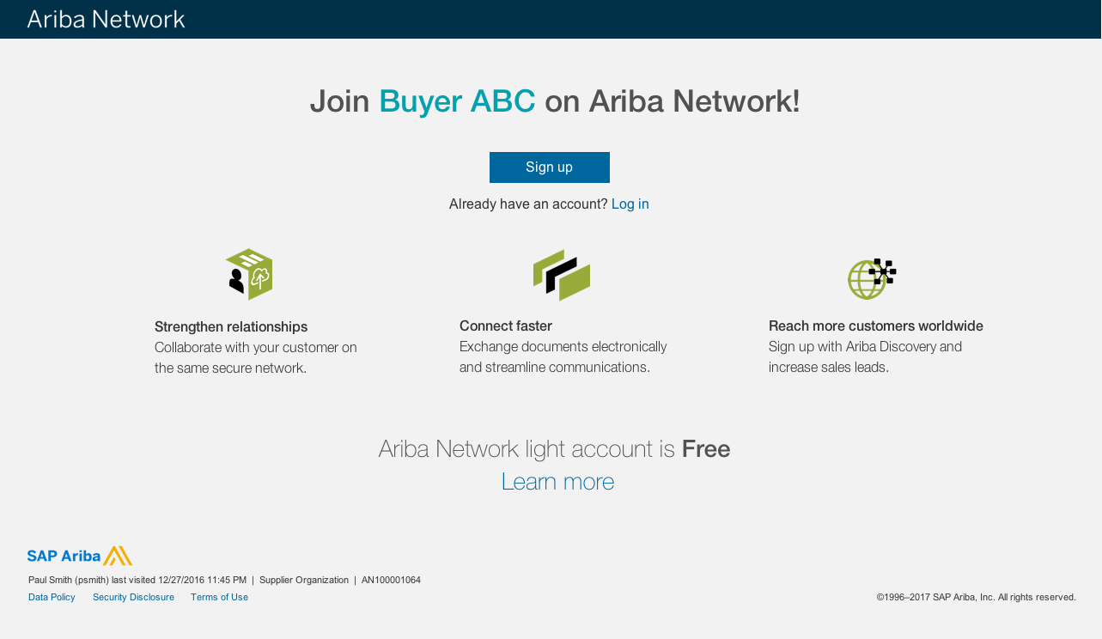
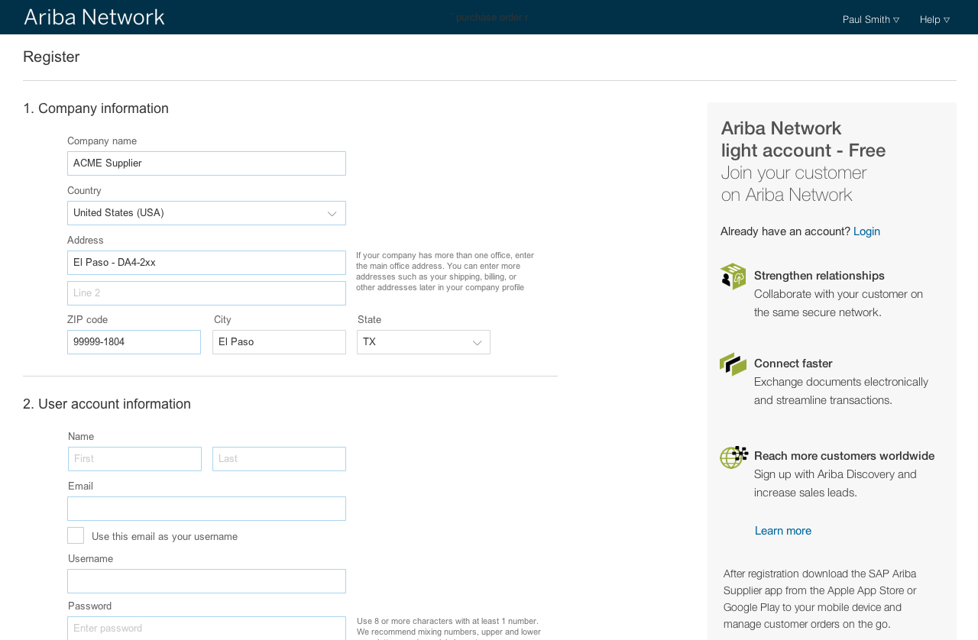
How light account benefits YOU
FREE for all basic transactions
Create validated, electronic invoices and other business documents within seconds
Improve invoice accuracy and get paid faster
Receive real-time invoice status notifications
Increase business with existing and future customers using Ariba Discovery
Promote your company to other customers on Ariba Network
Email notification and online download provide access to invoices for your local archiving
Enjoy a single, unified user experience using one account for order fulfillment, selling, and mobile access
Notes:
An Ariba Network light account will benefit your company in many ways:
* It is FREE for all basic transactions and you can Create validated, electronic invoices and other business documents within seconds
* While doing this, you will also Improve invoice accuracy, get paid faster AND Receive real-time invoice status notifications
* You can Increase business with existing and future customers using Ariba Discovery and Promote your company to other customers on Ariba Network
* Both Email notifications and online downloads provide access to invoices for your local archiving
* Finally, you’ll Enjoy a single, unified user experience using one account for order fulfillment, selling, and mobile access [>]

Slide 12
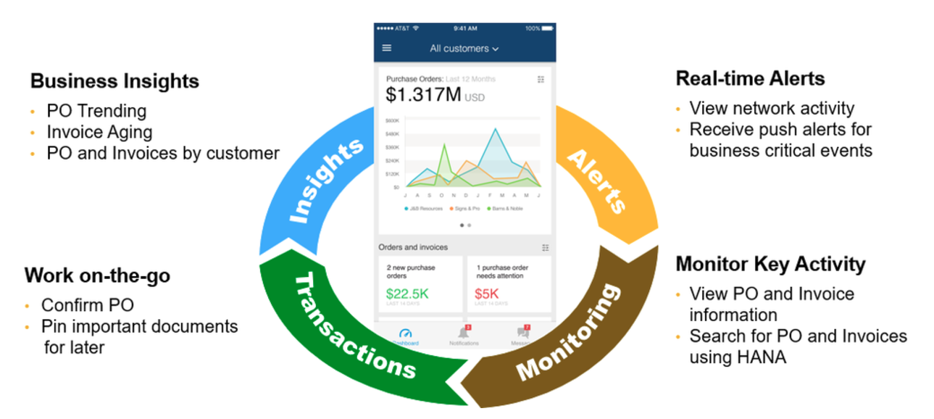
SAP Ariba Supplier Mobile App
Apple iTunes App Store or Google Play
Notes:
The SAP Ariba Supplier Mobile App gives you access to Ariba Network anywhere and anytime. Simply use your device to search FOR AND MONITOR POs and Invoices, all while receiving push alerts for key activities. This is available through the Apple iTunes App Store for iPhones or iPads Operating System 8.0 and higher, or on Google Play for Androids version 4.4 and up. [>]

Slide 13
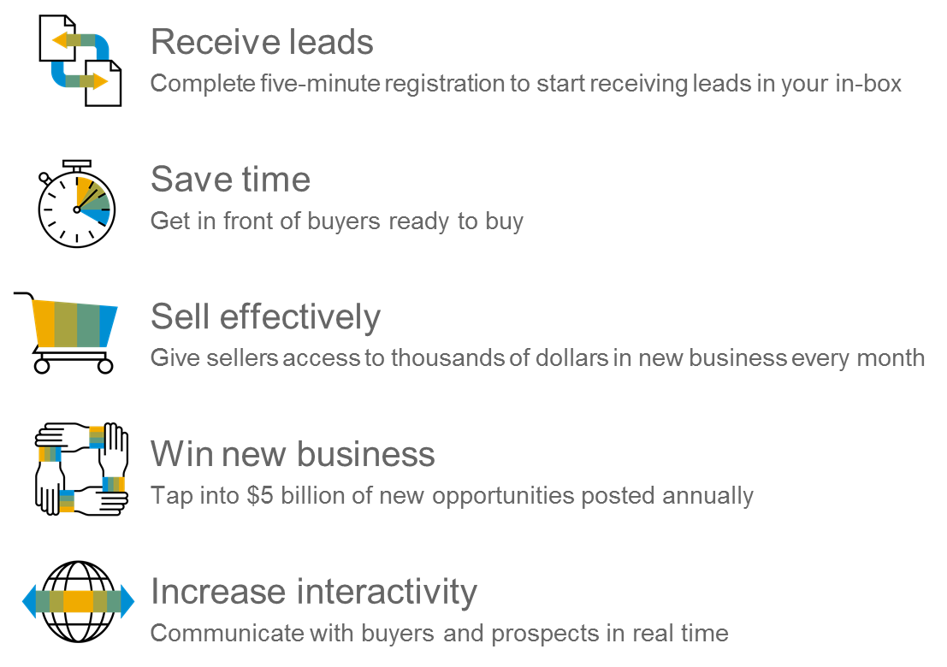
Ariba Discovery
Matching Suppliers to Buyers Ready to Buy
Notes:
You can transform your ability to find new customers - and maximize your Marketing and Sales opportunities - with the Ariba Discovery™ service. Ariba Discovery is an effective lead-generation tool and matching service that helps you promote your company and access thousands of business opportunities quickly, and easily, right from your existing Ariba Profile. Buying organizations around the world use Ariba Discovery to find new suppliers, and you will have access to buyer postings as soon as you set up your Ariba Network Account. [>]

Slide 14
Upgrade
Notes:
When using Ariba Network, light account you always have the option to upgrade to a full-use account to benefit from all of Ariba Network’s features. In the upcoming slides we will discuss how you can upgrade and what additional value a full-use account can provide to you and your customer relationships [>]

Slide 15
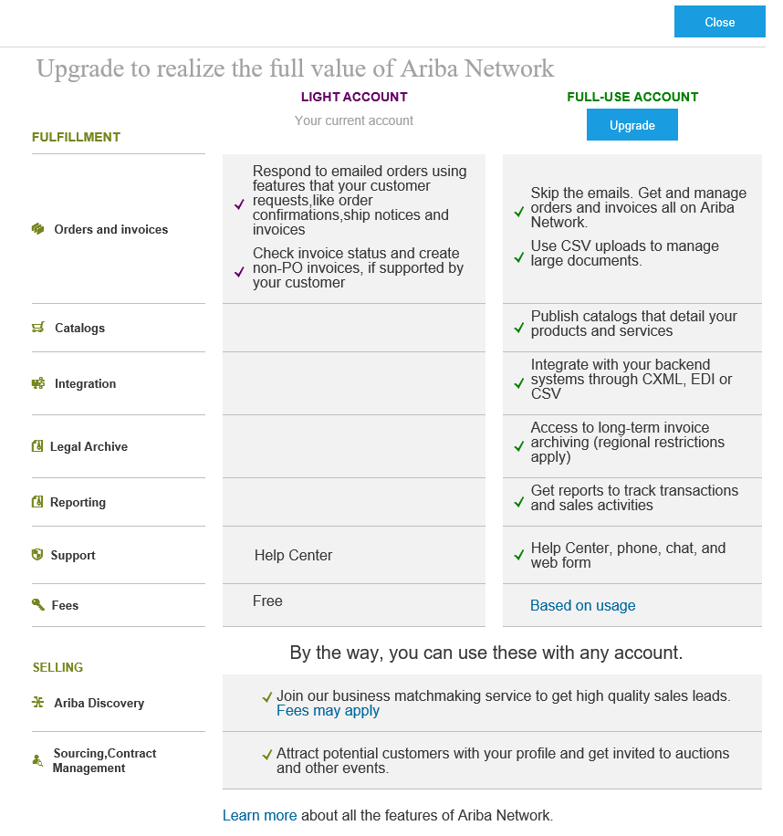
Home Page – Upgrade to Realize the Full Value of Ariba Network
Upgrade
Notes:
If you wish to upgrade your Light Account to a Full Account, you can do so in just a few clicks. [<] Start by clicking on the “Learn More” button at the top of your light account home page. When you click this button, you will be taken to a new page where you can review the differences between both types of accounts. It is important to note if you do decide to upgrade to a full- use account, you may be subject to fees to use the network. If you would like to learn more about Ariba Network fees, simply click on the “based on usage” hyperlink under the full use account to learn more. If you click on the Upgrade button and accept the terms of use, you will now have a full use account. [>]

Slide 16
Light Account vs. Full-use Account on Ariba Network
Features | Light Account | Full-use Account
Access | Through email notifications | Online dashboard
Company Profile |  | 
Purchase Order, Order confirmation (full & partial), Ship Notice, Service Entry Sheet, (Non-PO) Invoice, Credit Memo |  | 
Electronic Catalogs |  | 
Invoice status | Email notifications | Outbox with easy access from any browser
Legal Archive | Email notification and online download | Long-term invoice archiving for global compliance (Regional restrictions apply) Capability to mass download invoices for local archiving
Ariba Support | Online Help Center | Support via phone, chat, or email Direct access to enablement experts for onboarding assistance Technical support for configuration and integration assistance Online educational training courses
Integration |  | 
Reporting |  | 
Multiple customer relationships |  | 
Multi users |  | 
Mobile App |  | 
Ariba Discovery |  Fees may apply to respond to leads. Click here for more information. |  Fees may apply to respond to leads. Click here for more information.
Fees | FREE | Fees may apply, See complete details.
Notes:
The image on your screen now shows a side by side comparison of Ariba Network light account vs. a full-use account. With a full use account you’ll have access to catalog and integration protocols for a more automated user experience, long-term invoice archiving, and 24/5 global support for technical assistance. If Ariba Network full-use account is a better option for your company’s business, please follow the account upgrade steps to realize the full value of Ariba Network. It is important to note that Light Account is FREE for all basic transactions, but if you upgrade to a full-use account you may be subject to fees. [>]

Slide 17
Help Resources
Notes:
If you should have any questions regarding your light account, we have a few options available for your assistance. [>]

Slide 18
Supplier Help Resources
The Help Center will provide assistance while using your Light Account:
Click the Help Center link at the bottom of your interactive email
When logged into your light account, click the Help Center link in the upper right corner to expand the panel and gain access to relevant help topics
The Ariba Network, light account support page will provide access to:
A summary of light account features
A quick tutorial on how to replay and respond to your customer
Side-by-side comparison of light account and full-use account
The Supplier Success Session Portal to register for an upcoming live demo
A pre-recorded overview and demo of light account
https://support.ariba.com/ariba-network-light-account
Notes:
The Help Center will provide access to product documentation and shared best practices. You have two points of access to the help center:
You can access by clicking the Help Center link at the bottom of your interactive email, OR When logged into your light account, simply click the Help Center link in the upper right corner to expand the panel and gain access to relevant help topics.
The Ariba Network, light account support page will provide you with the tools and documentation needed, to successfully transact with your customer using Ariba Network, light account.
The light account support page summarizes light account features, upgrade details, and both recorded and live demos for your review.
You can download the Light Account Info Pack by clicking on the link in the resource list widget to the right of the slide on your screen now. [>]

Slide 19
Supplier Actions
Once you receive a Purchase Order, you will create an Ariba account and begin transacting with Moog
Not all sites/locations will be migrating to Ariba at the same time, so please continue to process Purchase Orders the same way in which you receive them
Notes:
The Help Center will provide access to product documentation and shared best practices. You have two points of access to the help center:
You can access by clicking the Help Center link at the bottom of your interactive email, OR When logged into your light account, simply click the Help Center link in the upper right corner to expand the panel and gain access to relevant help topics.
The Ariba Network, light account support page will provide you with the tools and documentation needed, to successfully transact with your customer using Ariba Network, light account.
The light account support page summarizes light account features, upgrade details, and both recorded and live demos for your review.
You can download the Light Account Info Pack by clicking on the link in the resource list widget to the right of the slide on your screen now. [>]

Slide 20
Q&A Session
Please submit your questions using the Q&A Widget
Moog Inc. Email Address:
MoogEnablement@moog.com (Ariba Network Registration or Configuration Support)
AribaSupport@moog.com (Moog Inc. Business Process Support)
Check out our website and our YouTube channel for more information!
http://www.ariba.com/suppliers/ariba-network-for-suppliers
https://www.youtube.com/user/AribaSpendManager/videos
Notes:
As mentioned earlier, we’re going to take some time for a Q&A Session. To submit a question to be answered by either the Thomas Reuters team or SAP Ariba, please send it via the Q&A Widget, which is located directly to the right of your slide view. (audio check)
Canned Questions:
ASK BUYERL Q: Can you talk to us more about the cutover date and what suppliers should expect around this time?
ASK NEL Q: Am I required to register on Ariba Network to use Light Account? A: Yes. You will be sent an interactive email from your buyer. To respond you must register for a free light account. This free account is not the
same as a full-use Ariba Network account. You only need to upgrade to a full-use account on Ariba Network when you determine that you desire
the additional functionality.

Slide 21
Thank You
Notes:
At this time I will now pass it back to <<buyer rep>> for some closing words.
And for all the suppliers on the line today, I would like to thank you for taking valuable time to learn more about this initiative between our companies. Our goal is to make this transition as simple as possible for you. Thank you again, this is the end of today’s summit.

Slide 22
Appendix

Slide 23
FAQ
Topics
Q: What is Light Account capability on Ariba Network?
A: Ariba Network, light account capability is a new, fast, free way to automate business with any buyer. Support for most transaction types helps
maximize efficiency and meet buyer compliance requirements. There is no need to upgrade, unless you are ready for advanced capabilities such
as support for catalogs, back-end integration or to manage larger document volumes through online access
Q: How can I access this new capability?
A: Your customer must send you a light account invitation to transact with them using this methodology. Or if you self register on Ariba Network,
SAP Ariba Discovery or you are invited to SAP Ariba Sourcing solutions and do not have or use an existing account (ANID) you can register and
will be started at the Ariba Network, light account capability level. In the latter case you will not exchange orders and invoices with your customer
unless they establish a relationship with your account first but you can use other functionality.
Q: What document types are supported for this free account?
A: Suppliers transact unlimited documents such as orders, order confirmation (OC), advance ship notices (ASN), and service entry sheets (SES),
PO-invoices using PO-Flip (convert orders into an e-invoice with the simple click of a button), non-PO invoices and credit memos, invoice status
notifications, payment proposals, and remittance details.
Q: What if I have already signed up for Ariba Network? Can I switch to Light Account?
A: If you are already using Ariba Network with a buyer, we recommend that you continue using this transaction method. There is no direct way to
change an Ariba Network subscription (full-use account) to a light account.
Q: Am I required to register on Ariba Network to use Light Account?
A: Yes. You will be sent an interactive email from your buyer. To respond you must register for a free light account. This free account is not the
same as a full-use Ariba Network account. You only need to upgrade to a full-use account on Ariba Network when you determine that you desire
the additional functionality.
Overview
Next Steps
Benefits
Upgrade
Help
FAQ
More FAQ

Slide 24
FAQ
Topics
Q: How do I invoice a purchase order if I lose the email notification?
A: If you misplace a purchase order (PO) email notification, you have the following options:
Resend the PO email: Log in to your Ariba Network light account. In the PO list on the home dashboard of your account, click
Select > Send me a copy to take action in the Action column next to the PO.
Request a manual copy of the PO from your customer: After you have a copy of the PO, you can create and submit a non-PO invoice.
Q: How do I create documents against purchase orders from my customer?
A: To process a purchase order, you need to click the Process Order button in the purchase order email notification.
After you register or log in to your Ariba Network light account, you are taken to the purchase order details page, where you can
create documents like order confirmations, ship notices, and invoices against the purchase order.
Q: How do I add purchase orders to my existing Ariba Network Account?
A: If you've previously registered a light account or full-use account on Ariba Network to transact with a different customer, you
have the option to add the transactions with your new customer to your existing account.
To add your new purchase orders to your existing account:
1. In the purchase order email notification, click Process order and then click Log in on the light account landing page.
2. Log in with the administrator username and password for the existing account.
Q: What should I do if my registration confirmation link is expired?
A: If the confirmation link expired immediately after receiving the email, please log in to your account
directly at https://supplier-2.ariba.com
If the confirmation is accepted, you will be able to view your account. If you are unable to access your account, you can request to
resend the confirmation email.
Overview
Next Steps
Benefits
Upgrade
Help
FAQ

Slide 25
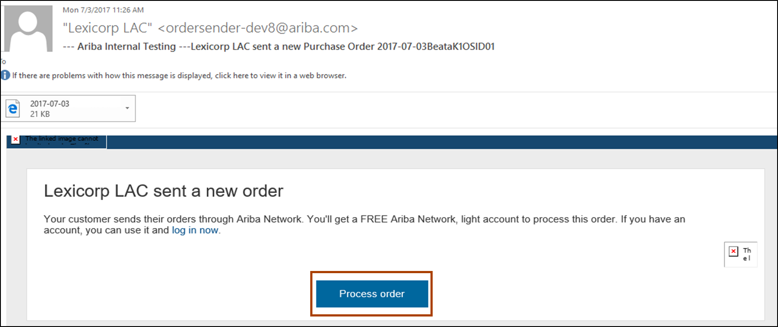
Receive Interactive Email Order from Customer
Click the Process Order button in the PO notification (interactive email)
Next step

Slide 26
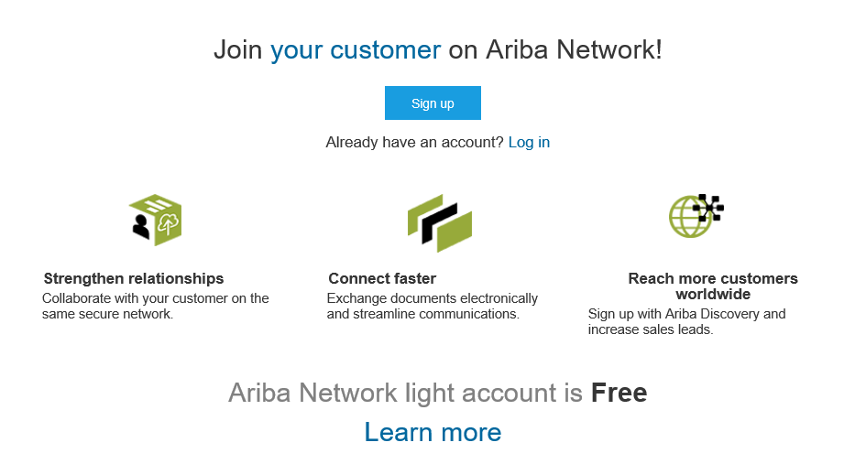
Sign Up for light account
Select the Sign up option to create a new light account
-OR- use your existing light account by clicking on Log in
Next step

Slide 27
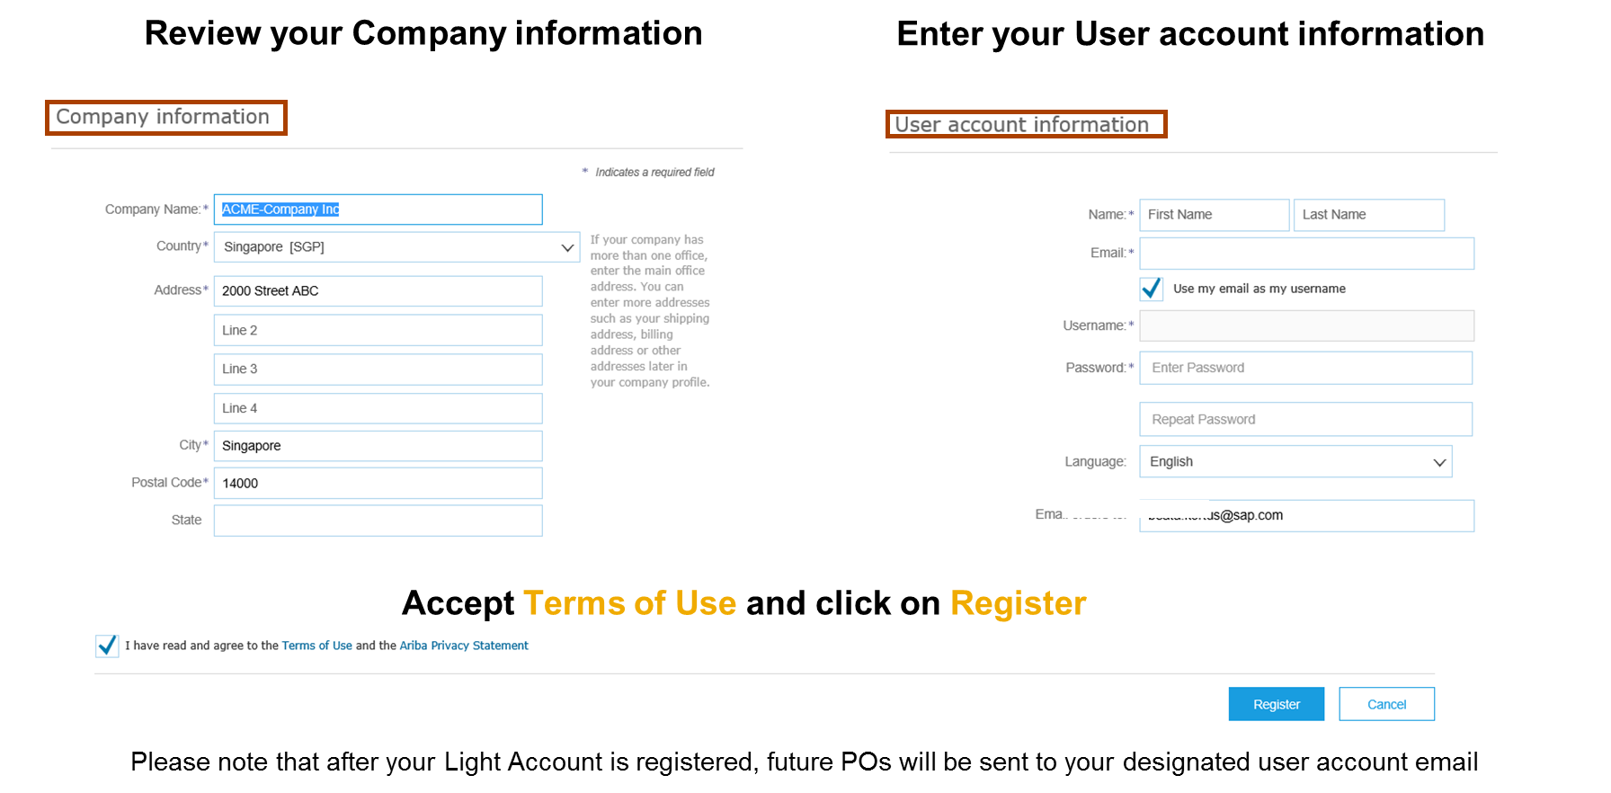
Configure Account, Accept Terms of Use, and Register
1
2
3
Next step

Slide 28
Transact with customer using light account
Click on Create Order Confirmation, Create Ship Notice, or Create Invoice to get started.
1
2
If you need assistance, please refer to the articles in the Help Center (right-hand side).

