Slide 1
Light Enablement Functional Training SAP Ariba
Notes:
As a start let’s review our vision for Supplier Onboarding: our goal to digitize the whole supplier base because there are barriers today in conducting commerce → we want to eliminate them.
As we are supporting a 2 sided model Supplier participation is crucial to conduct commerce and to achieve the business case
BUT the big problem is – not all suppliers are same…small/large, some have technology barriers, integration needs etc. Best practice is to segment them in 3 groups A, B, C.
A: needs full enablement out of the gate, e.g. vendors will legacy EDI integration or catalogs. Good news that makes up only ~2-5% of the active vendor base
B and C: can and should be enabled on the fly
BUT so far it takes years to get all suppliers onboard → Why? Because we have tried to enable not only the A category but also B before buyer go live and worst: many enabled suppliers turned out to be not even active anymore → a complete waste
That’s why we now have the Light Enablement methodology.

Slide 2
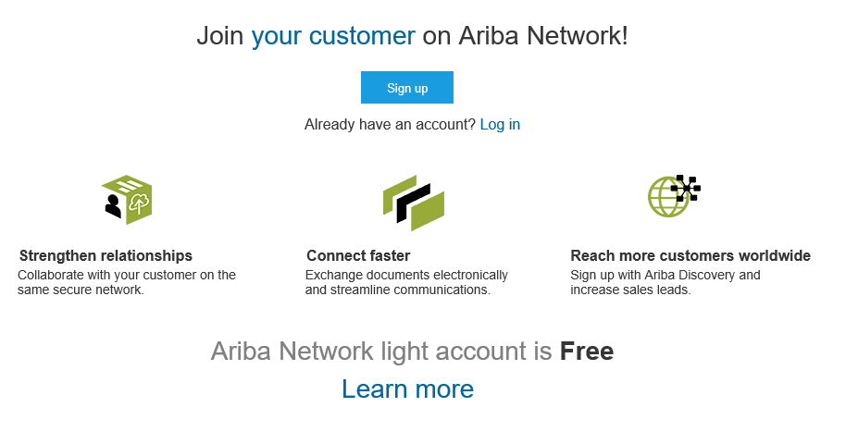
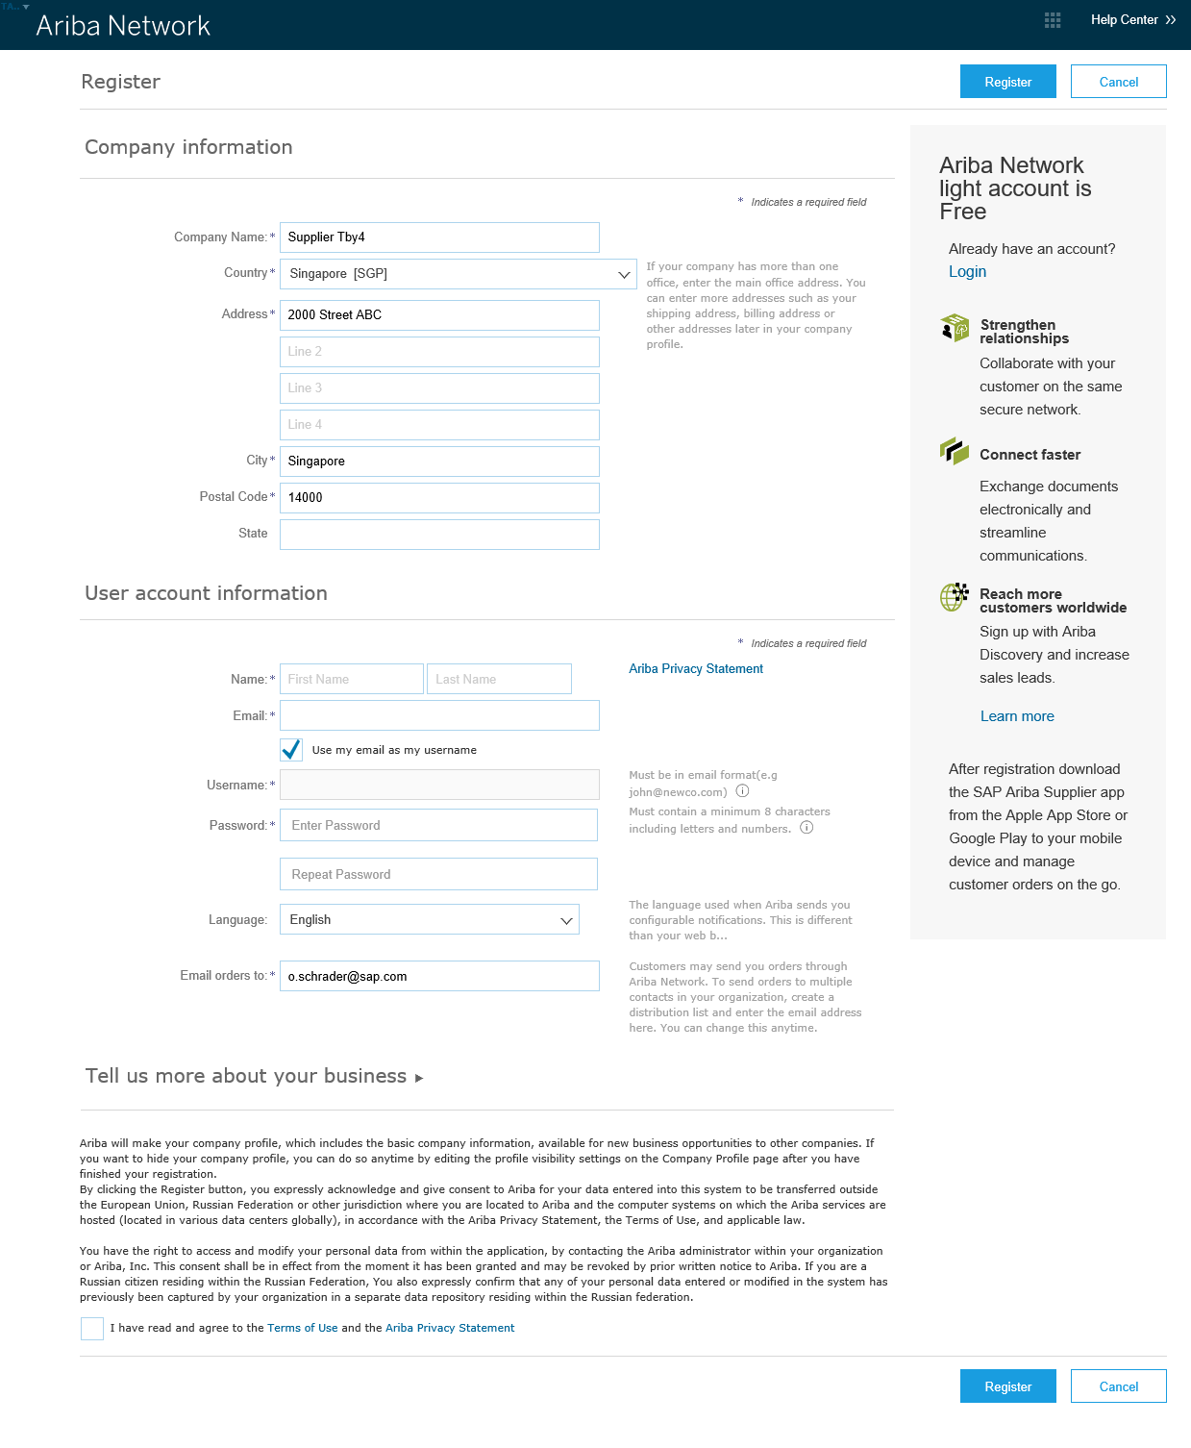
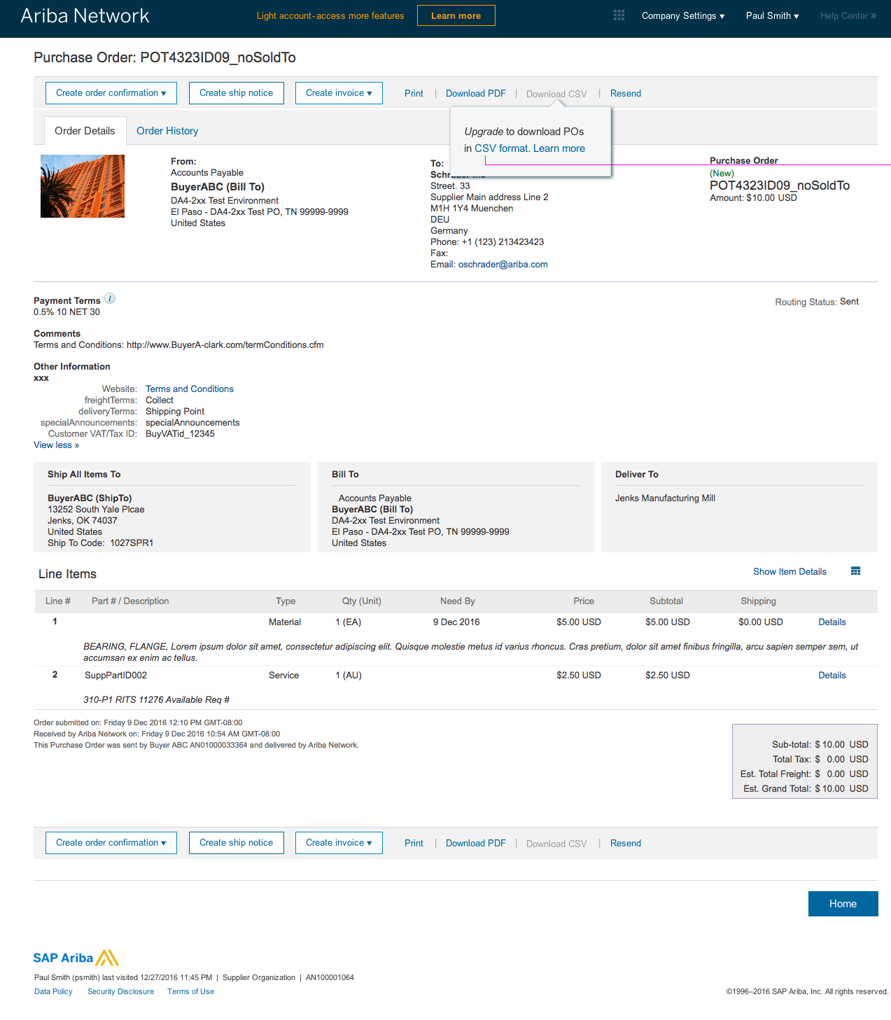
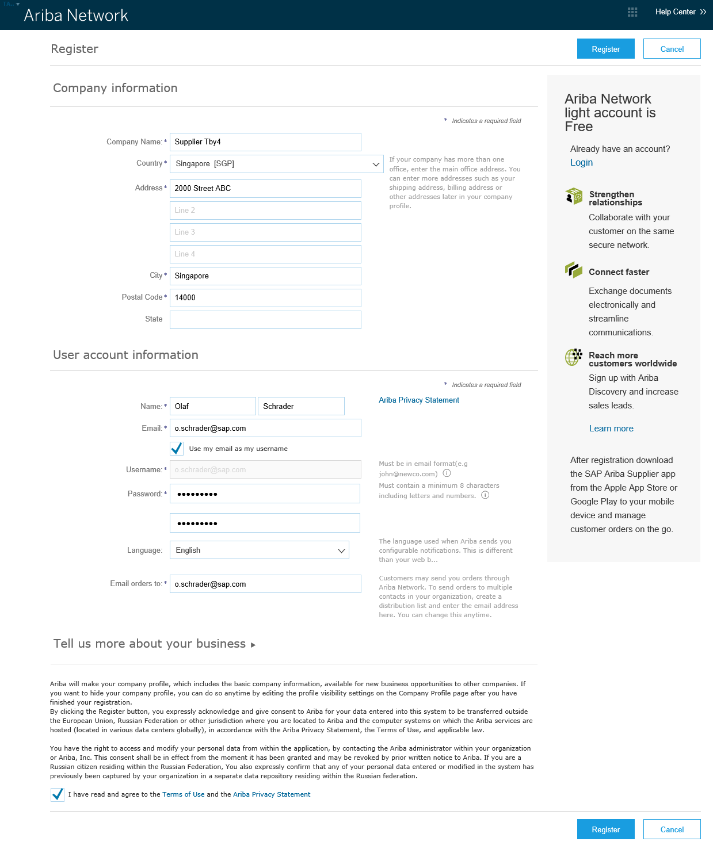
Sign-up to Light Account from IE – Order
Sign up
Process order
…
…
Register
See slide Notes
Notes:
Interactive Emails → Light Account
Customer content
Frist time “action” trigger
Light Account Registration (pre-filled with vendor provided by the buyer)
Or supplier can use existing light or upgraded account (Login)
Then direct access to
Order
and actions like OC, ASN, Invoice …

Slide 3
Interactive Order – Email (unregistered)
…
5
Standard welcome text
Attachments
HTML Order
Customer files (optional)
Customer text and logo
Process order Button
Drives to register
Order
Header
Other Information
Attachments
Lines
FAQ
Help Center
5
1
4
5
Standard welcome text hidden if customer text was provided in letter language
2
3
4
6
…
7

Slide 4
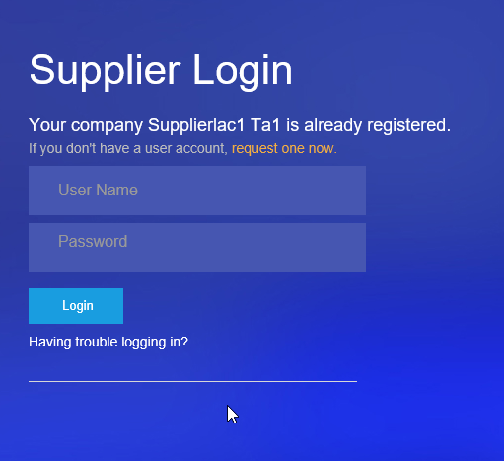
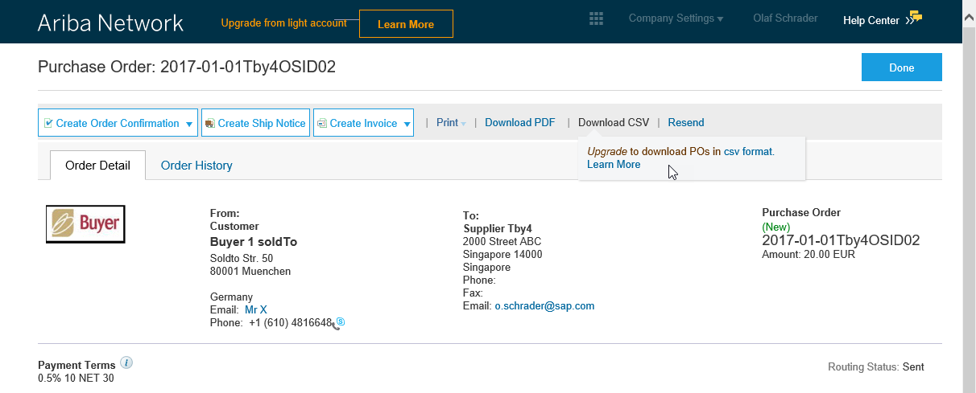
Registered Account:
IE-Order Flow
From Interactive Email documents
→ supports “forward” use case to user B
User B without login can contact the account admin
→ after Login access to
Order
Create* OC, ASN, SES eInvoice, …
* availability depends on document status and on buyer business rules
Request user account
(forward case)
Not available features are grayed out
(mouse over provide context)

Slide 5
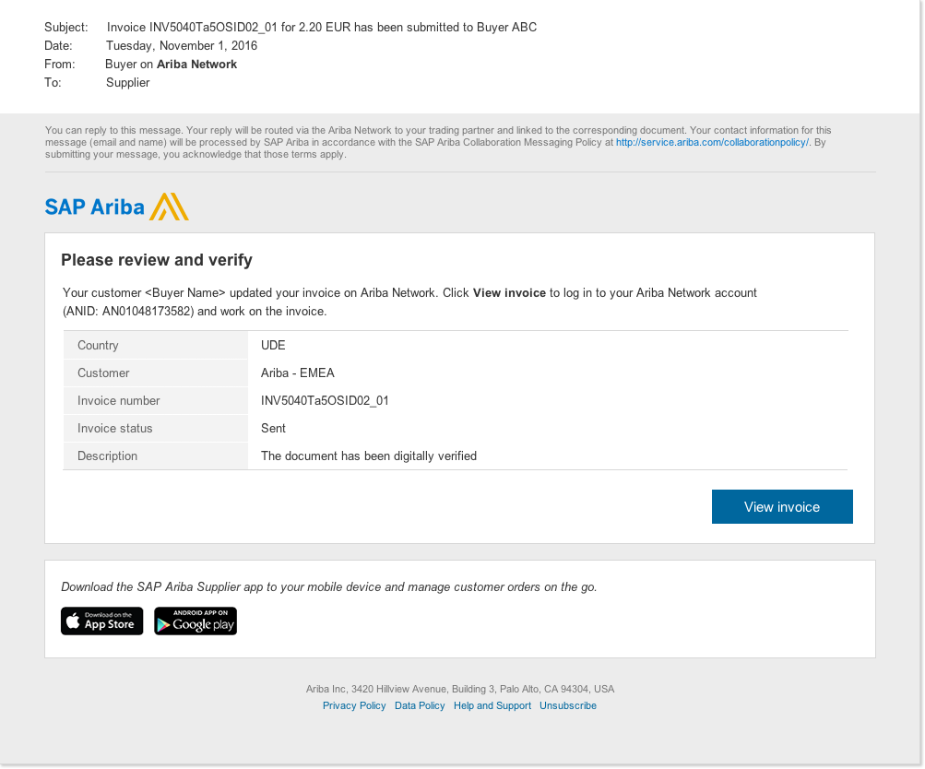
Invoice Status Flow
From Interactive Email documents
→ After Login access to*
Review Invoice Status
Delete
Create Credit Note
Copy Invoice
* availability depends on document status and on buyer business rules
Note
Auto generated notification will be send to the suppliers
The document was added to the pending queue for download. (or similar)
If e-Invoice are e-signed 2 additional auto generated status notifications will be send
This document has been digitally signed.
This document has been digitally verified.

Slide 6
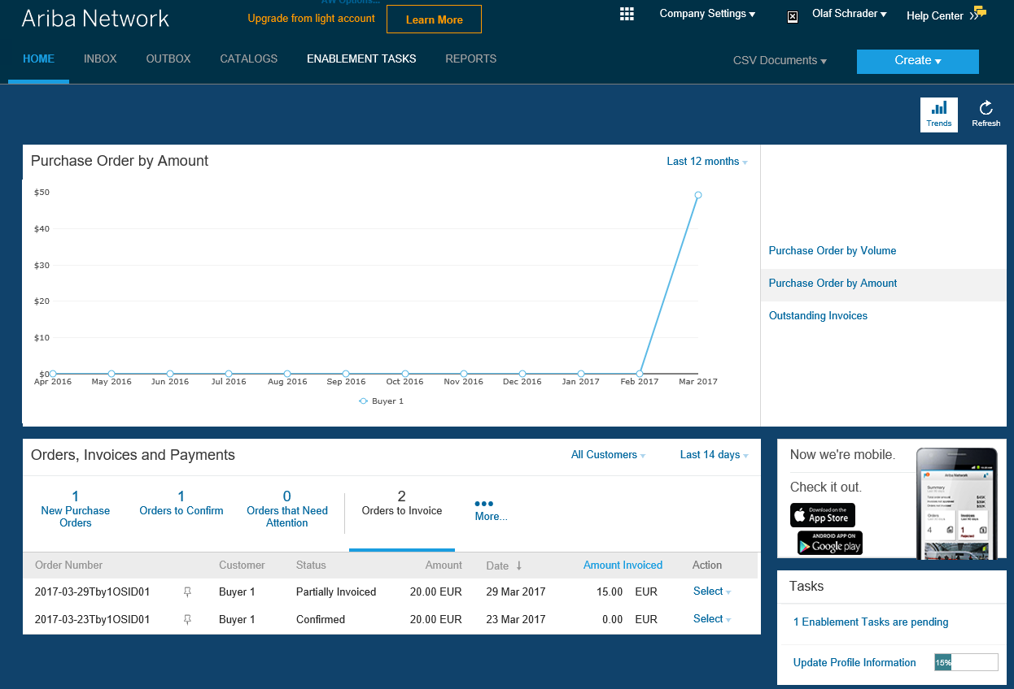
Home Page 1/2
Trends
Change List view Limits
Order and Invoice List view
Action: send me a copy to take action

Slide 7
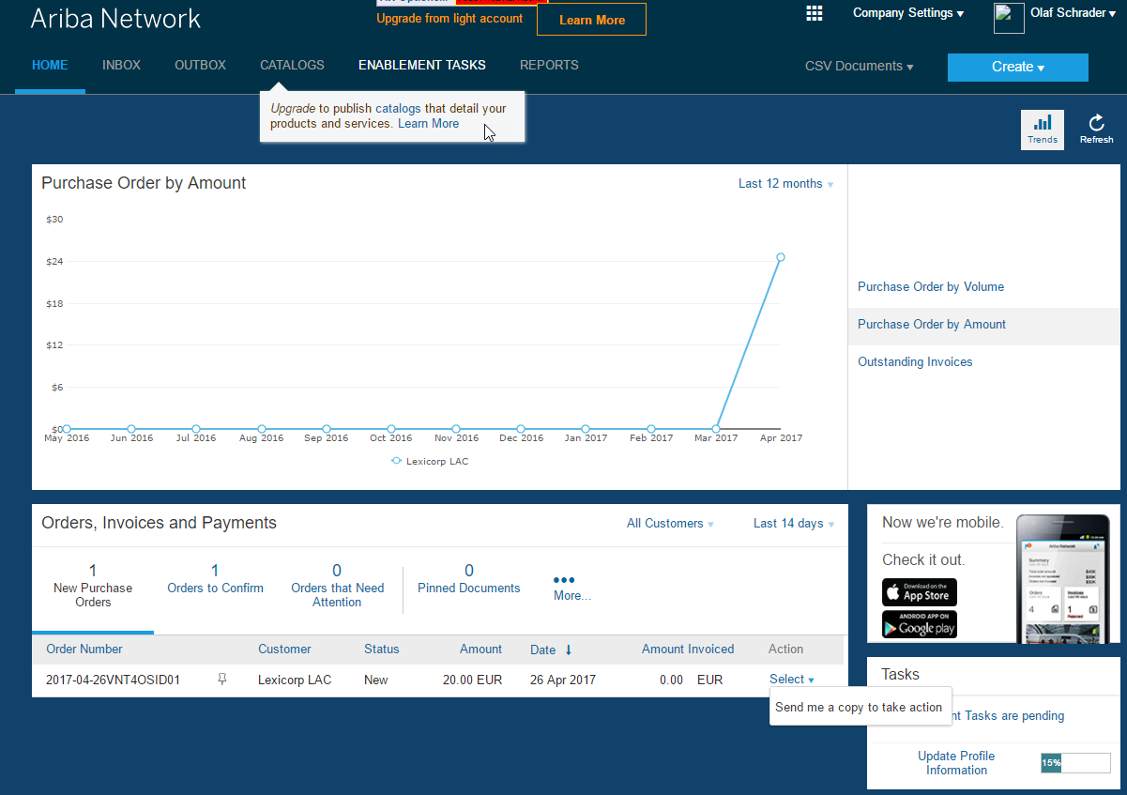
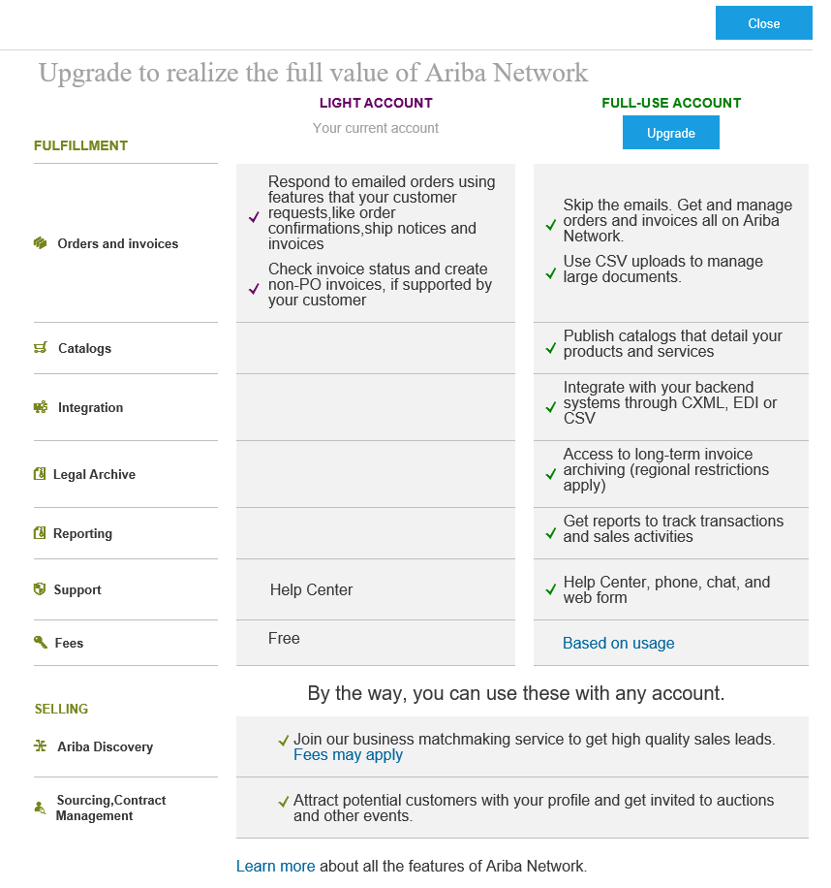
Home Page 2/2
4
Home Page
Create
Non-PO Invoices
Credit Notes
List view with send me a copy to take action
Deactivated features
Inbox/ Outbox
Catalogs
Reports
CSV Documents
Learn More
→ upgrade to full-use account
Permission controlled
3
1
2

Slide 8
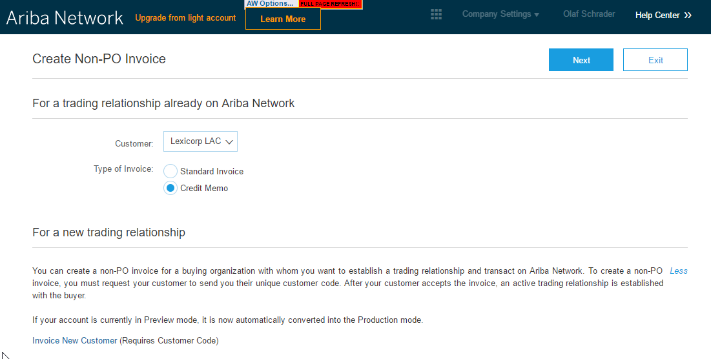
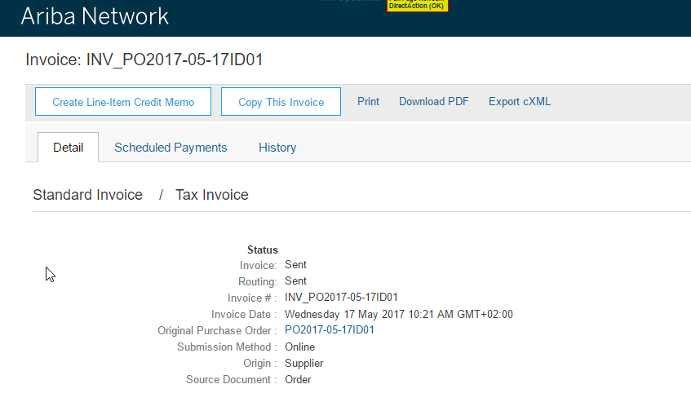
Credit Notes
Home Page
Non-PO Credit Notes*
From Home Page
PO Credit Notes*
From Invoice Page
1
2
* Buyer specific Business Roles control availably

Slide 9
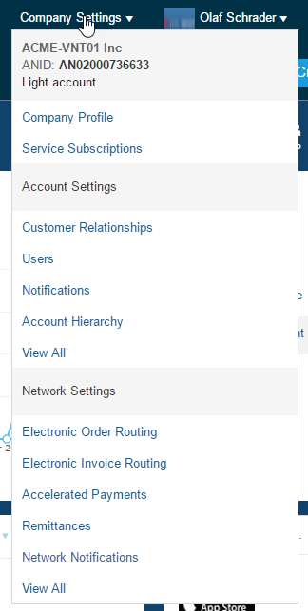
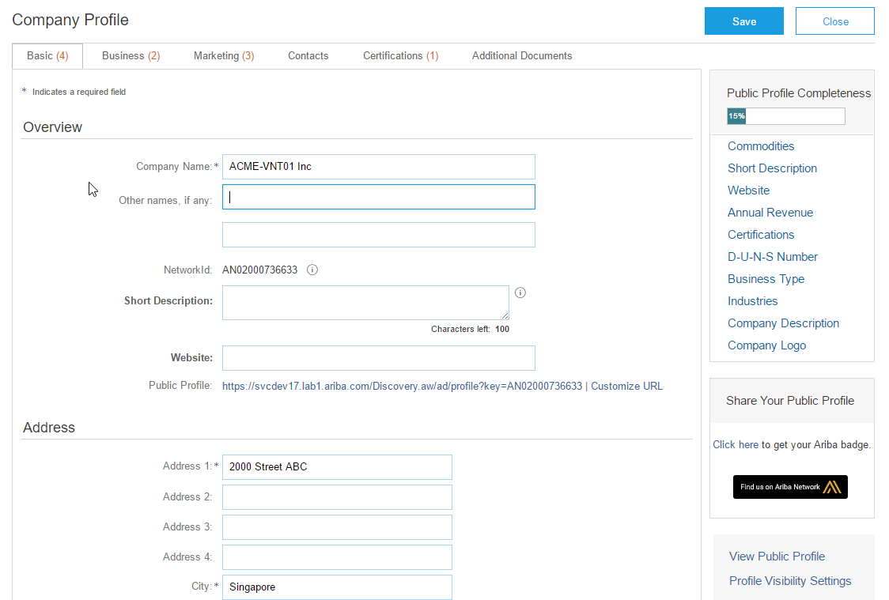
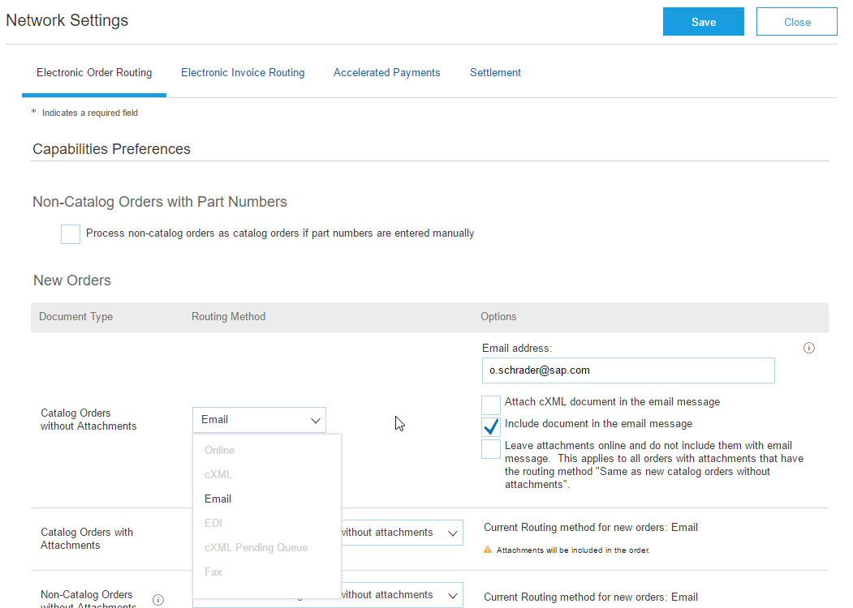
Account Settings
Company Settings
Almost all full-use setting are available
Restrictions for
Order routing: only email
Archiving
Order routing: only email

Slide 10
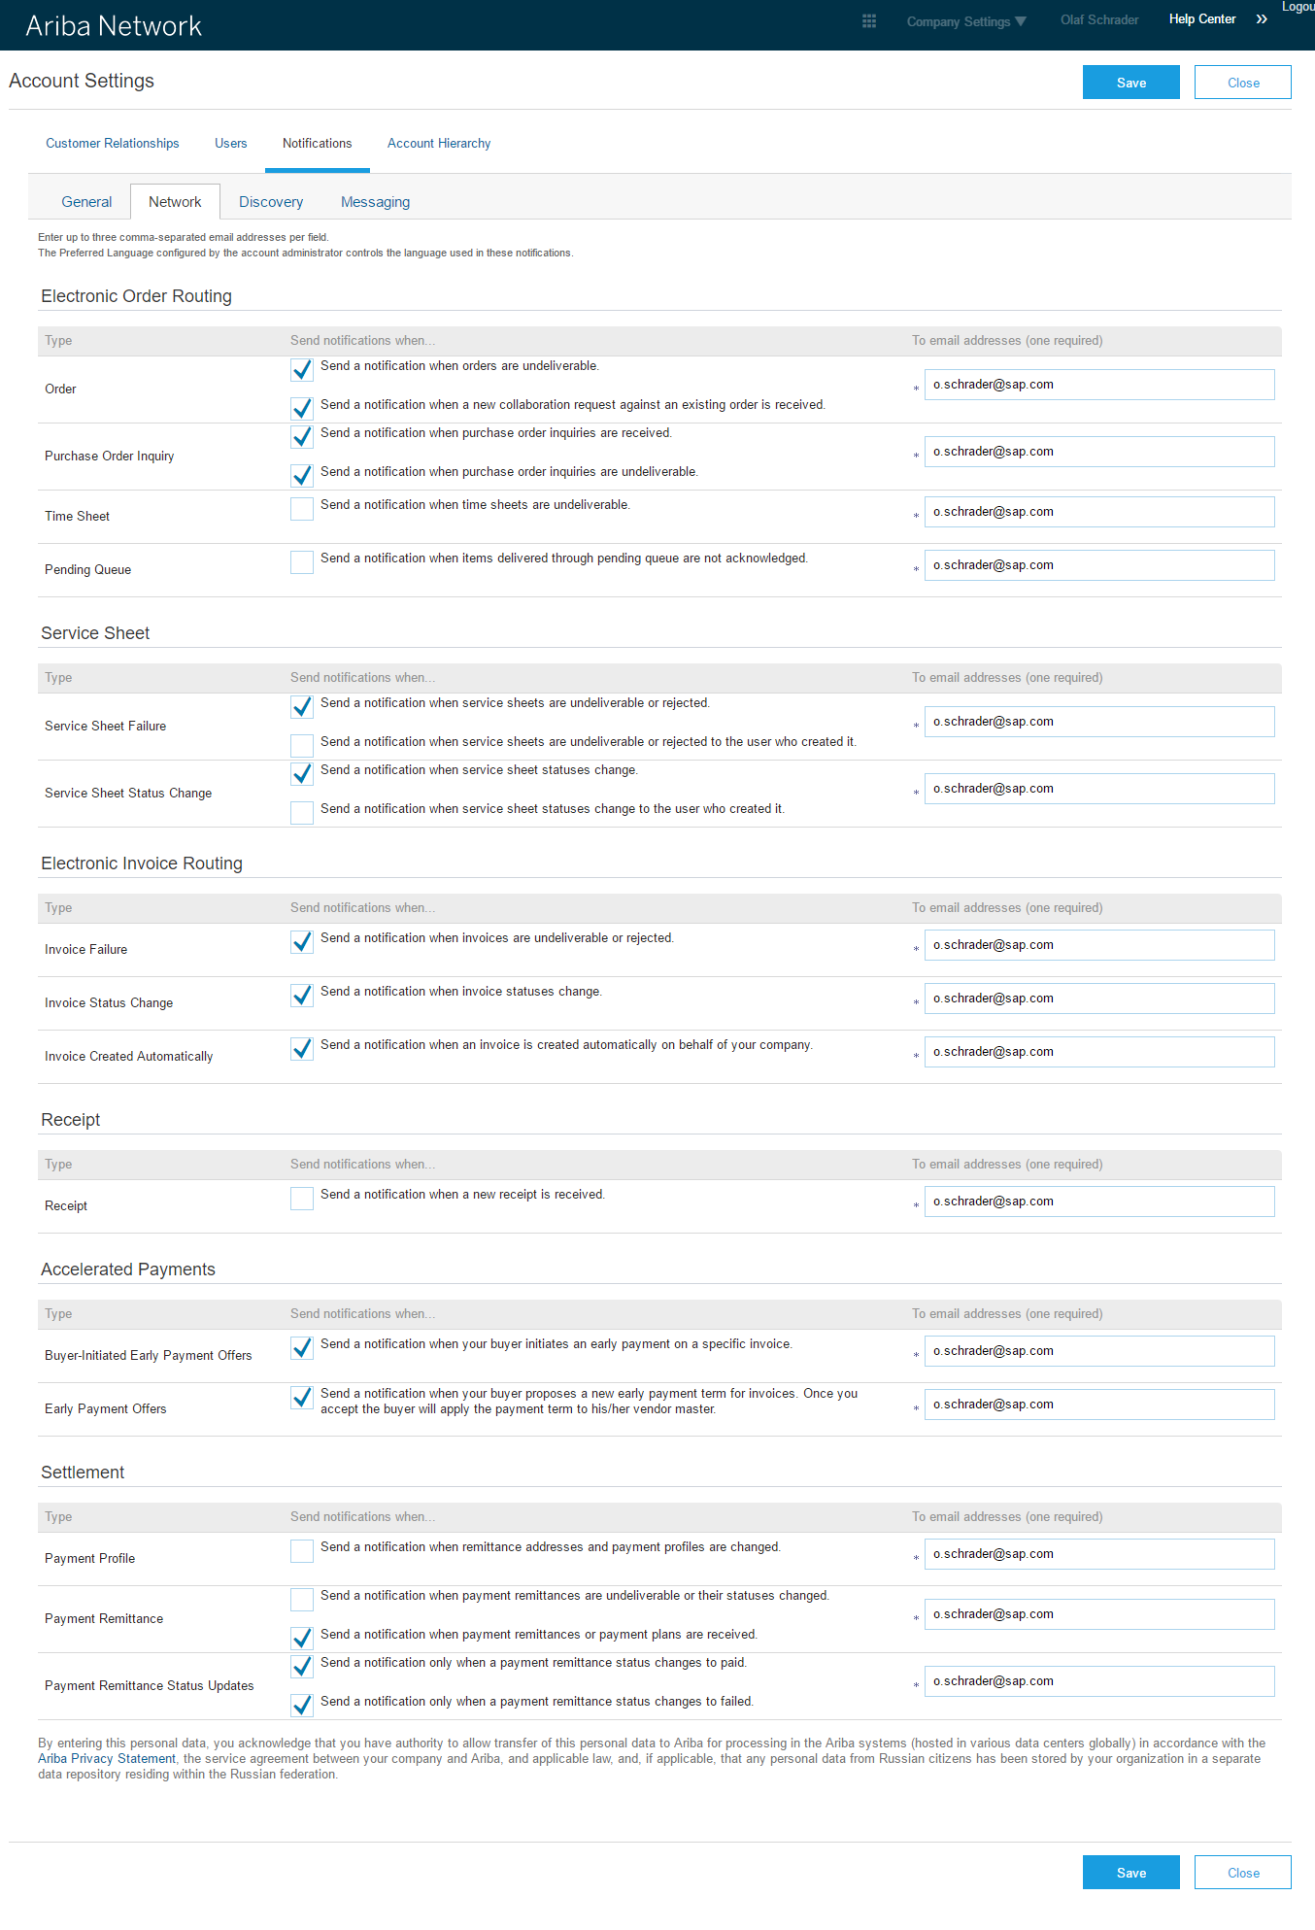
Notification routing and setup
Unregistered account
The latest email in the trigger document (in correspondent cXML section) will be used to route the document
Registered account
Defaulted to account admin email
Selected notification will be activated
Orders failed
Service Sheet
Invoice status updates
Early Payments
Remittance Advice

Slide 11
Questions?

